Slide 1
Cellular movement Mechanotransduction
László Kőhidai Med. Habil.; MD, PhD,
Assoc. Professor
Chemotaxis Research Grooup
Department of Gneteics, Cell- and Immunobiology
Semmelweis University
October 29 - 2020

Slide 2
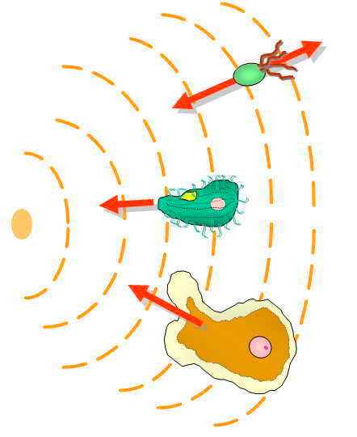
Significance
Cells
Cytoskeleton
Ligands
Clinical
significance
Mechanotaxis
Chemotaxis
Phylogeny
Signaling
Types

Slide 3
Cell migration – Its significance in biology

Slide 4
Notes:
Attraktáns - repellens

Slide 5
Chemoattractant materials
Chemorepellent materials

Slide 6
Galvanotaxis
_
+

Slide 7
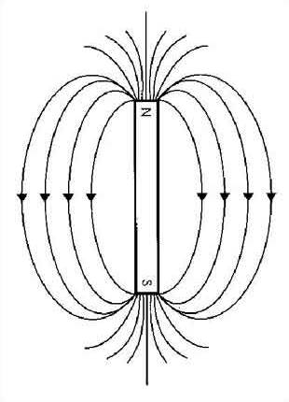
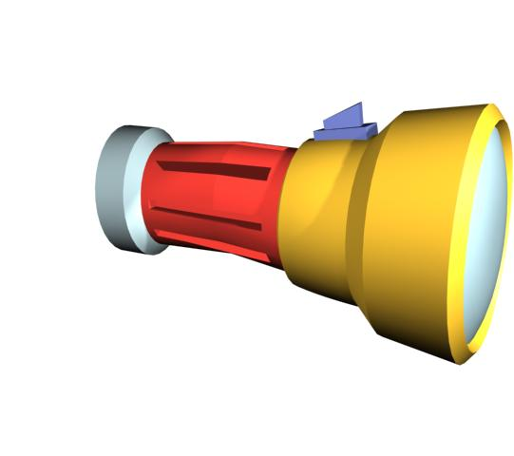
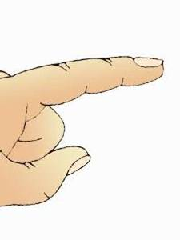
Environmental effects inducing cell migration
Magnetotaxis
Phototaxis
Electrotaxis
Thermotaxis
Tigmotaxis
Geotaxis
Duro/Mechanotaxis
Chemotaxis

Slide 8
Migration induced by physical and chemical stimuli - Phylogeny
Moisture
Magnetic fileds
Electric fileds
Light
Temperature
Hydrotaxis
Magnetotaxis
Electrotaxis
Phototaxis
Physical
stimuli
Thermotaxis
Physical
contact
Chemotaxis
Chemicals
Thigmotaxis
Barotaxis
Rheotaxis
Mechanotaxis
Geotaxis
Pressure
Fluid flow
Stiffness
Graviry
Notes:
cím

Slide 9
Chemotaxis – Significance in biology
!
Helps to distinguish / to approach food molecules
Helps to avoid biologically harmful/toxic substances
Sperm to approach oocyte - fertilization
Tissue transformation processes (e.g. CNS)
Immune reactions of multicellular organisms
Proliferation and growing of tumors, formation
of metastasis

Slide 10
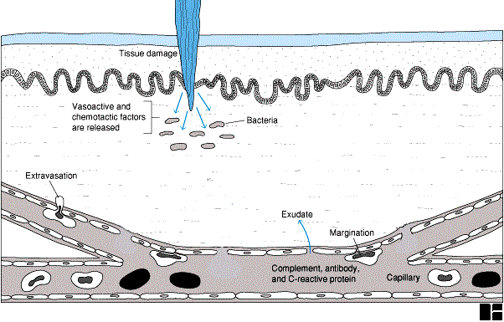
Main steps and objective of migration in tissues
?

Slide 11
!
Significant components to elicit cell migration
A sejtvándorlás lépései és célja
Cytoskeleton
Substance
influencing
cell migration
Receptors
(intracellular signaling)
Notes:
Receptor – intracell sign

Slide 12
!
An important factor - Size of the cell
Bacteria (small to detect concentration):
continuous scanning the environment
Small Δ conc.
Big Δ conc.
Eukaryotes:
Migration directed by concentration gradients

Slide 13
Types of cell migration

Slide 14
A B

Slide 15
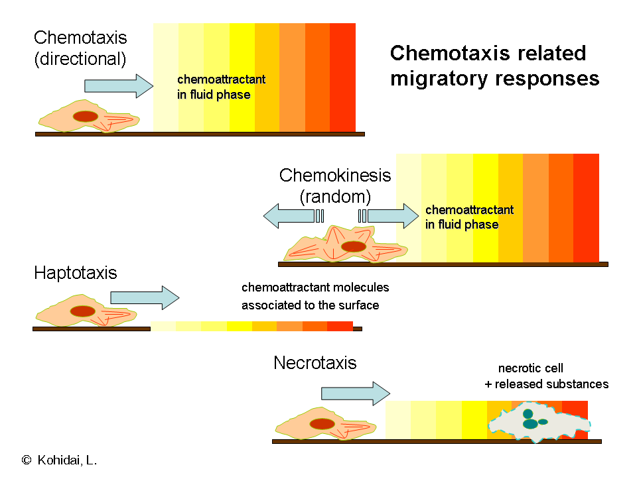
Nekrotaxis
!

Slide 16
Chemotaxis is a cell physiological reaction and part of a three member process.
Cell adhesion is (regularly) required for migration.
Phagocytosis is the most essential target reaction of migratory cells.
Adhesion
Chemotaxis
Phagocytosis

Slide 17
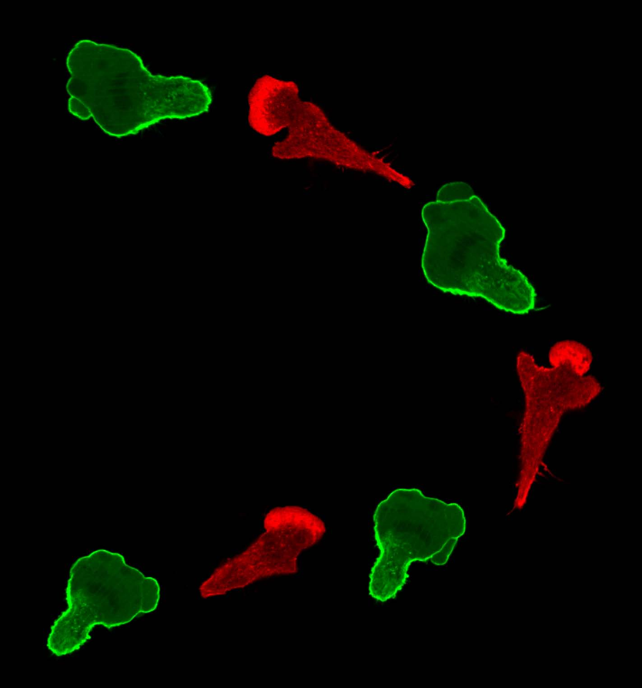
Migratory cell types
Martin Bergert, Max Planck Institute of Molecular Cell Biology and Genetics

Slide 18
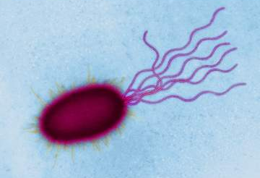
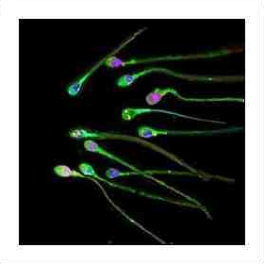
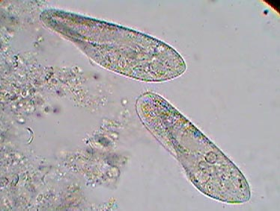
Cells with 3D migration – Fluid phase
Cells migrating in the 3D space with no limiting factor.
bacteria
ciliated eukaryotes
spermium

Slide 19
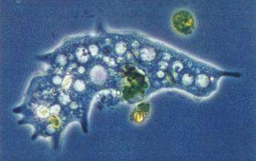
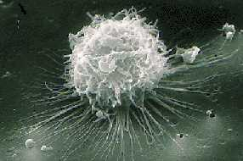
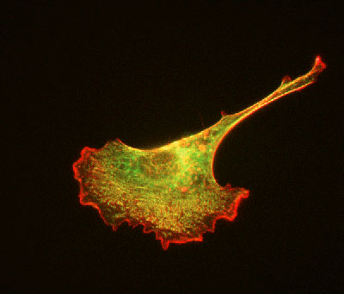
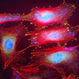
Cells with 2D migration – Solid surface
amoeba
monocyte / macrophage
Cells require solid or semi-solid surface for migration.
fibroblast
endothel

Slide 20
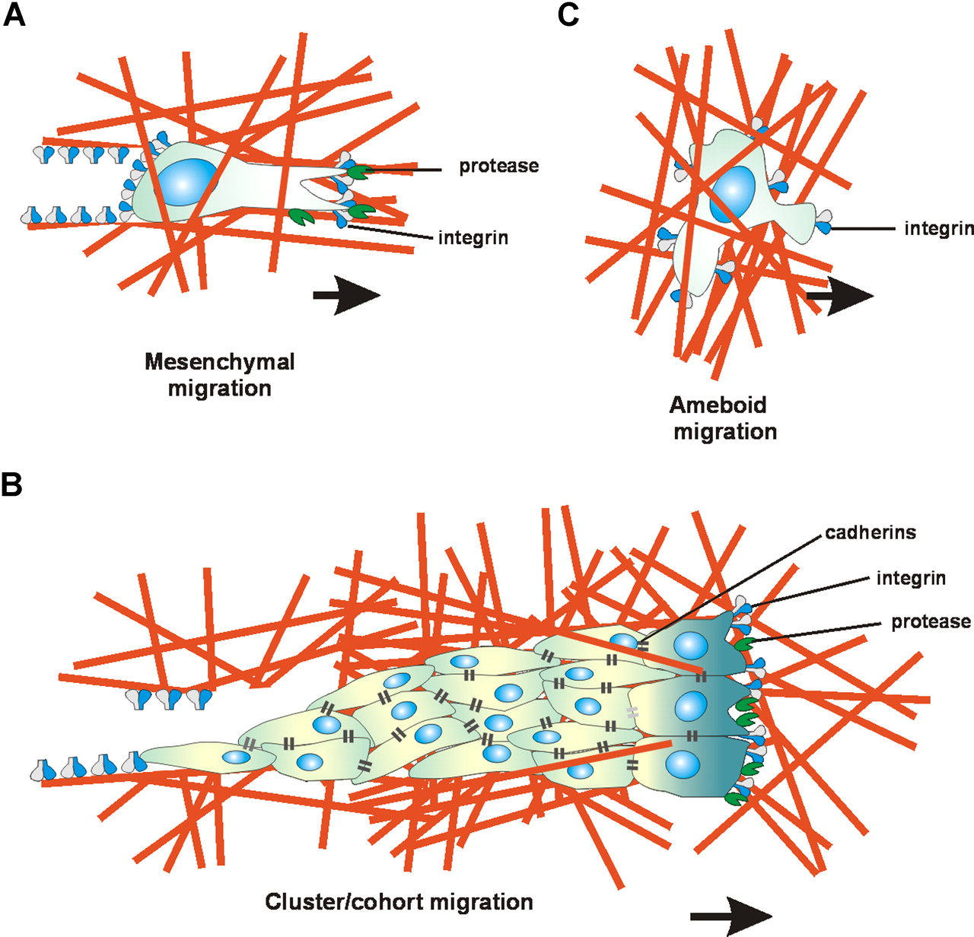
Migration in Extracellular matrix (ECM)
Polarized cell; on frontal edge enzyme release
The most fundamental way of migration in ECM.
e.g. macrophage
e.g. lymphocyte
Groups of cells kept together by cell adhesion molecules – migrating together.
e.g. tumor cells
BLOOD, 1 NOVEMBER 2007 VOLUME 110, NUMBER 9
Notes:
Amoboid? sorrend

Slide 21
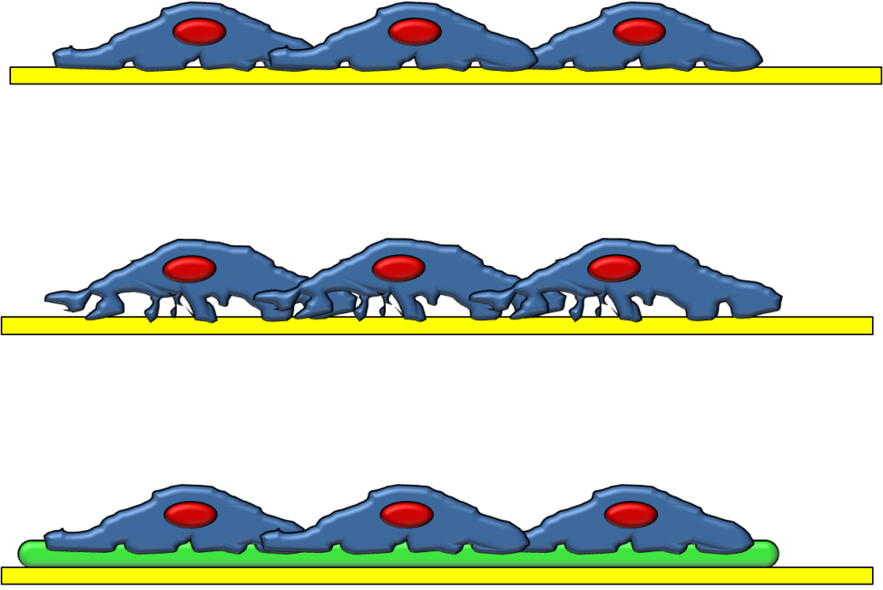
Micromotion activity of cells
A constant rotation is detectable
even in confluent layers of cell cultures.
Quality of ECM can influence of
characteristics of micromotion.
Ectracellular matrix
Lang, O., Kohidai, L., Wegener, J. Electrical noise analysis as a tool for screening the metastatic potential of tumor cells. In prep.
Notes:
Mi a zöld ?

Slide 22
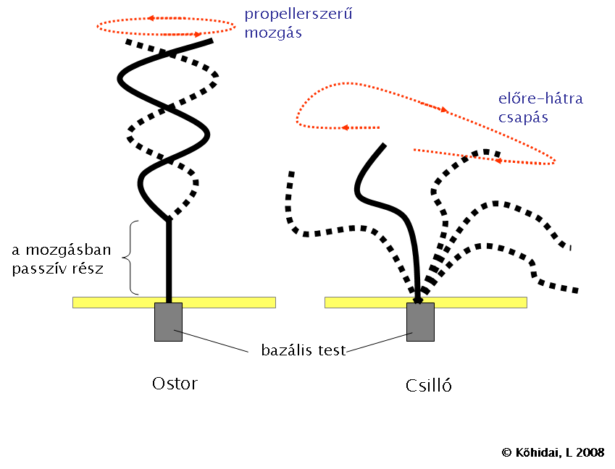
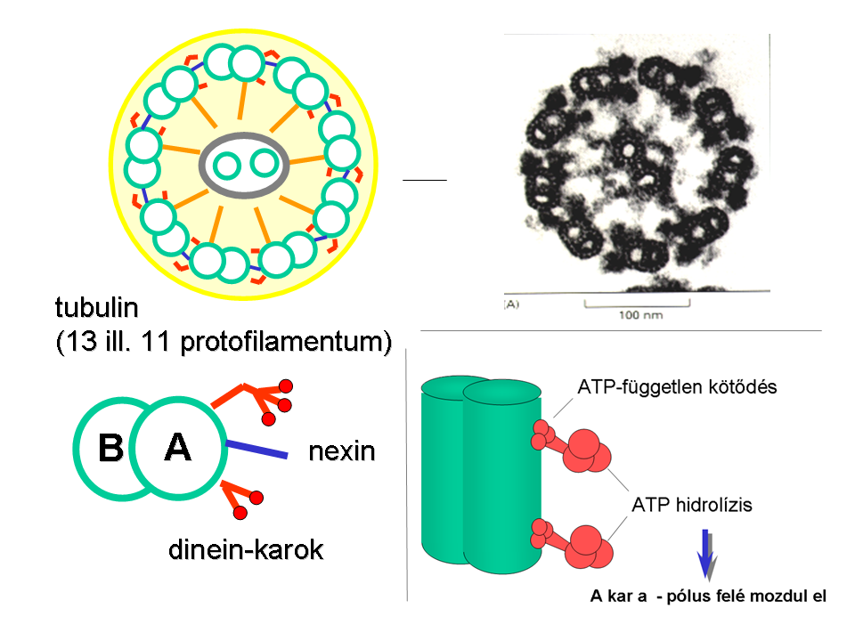
Cilia and flagellum – Structure and function
propeller like
movement
beating
back-and-forth
in motion
passive part
9 x 2 + 2 microtubuli
basal body
Flagellum
Cilia
tubulin
(13 or 11 protofilaments)
ATP-independent binding
nexin
ATP hydrolysis
dynein arms
Arm moves toward the negative pole
Notes:
Csilló

Slide 23
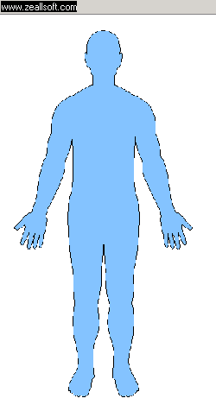
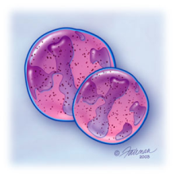
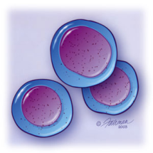
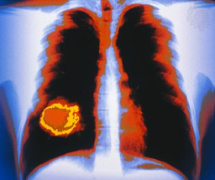
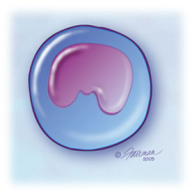
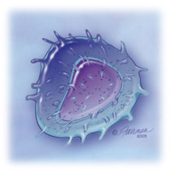
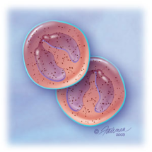
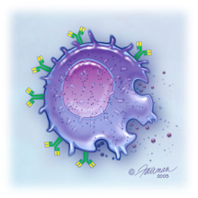
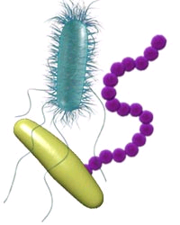
Healthy body with migratory cells (immune system);
Motile bacteria invading body.
Tumor attacked by immune system;
Metastasis formation.

Slide 24
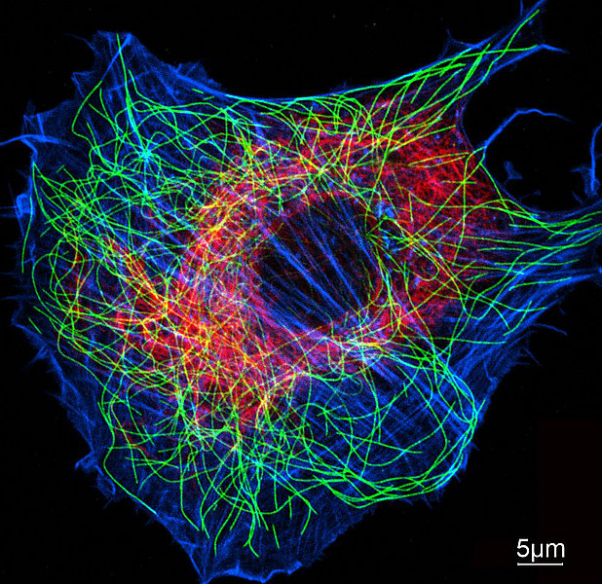
Cytoskeleton
biozentrum.unibas.ch

Slide 25
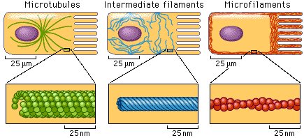
!
Microtubules Intermedier filaments Microfilaments
intermedier filaments
e.g. vimentin
microtubule
deformation
Buffering effect of intermedier filaments
= rupture
actin filaments
force

Slide 26
SLIDING
!
Globular proteins
Ca²⁺
ATP
Fibrillar proteins
General basic phenomenon of interacting proteins resulting migratory responses of cells.

Slide 27
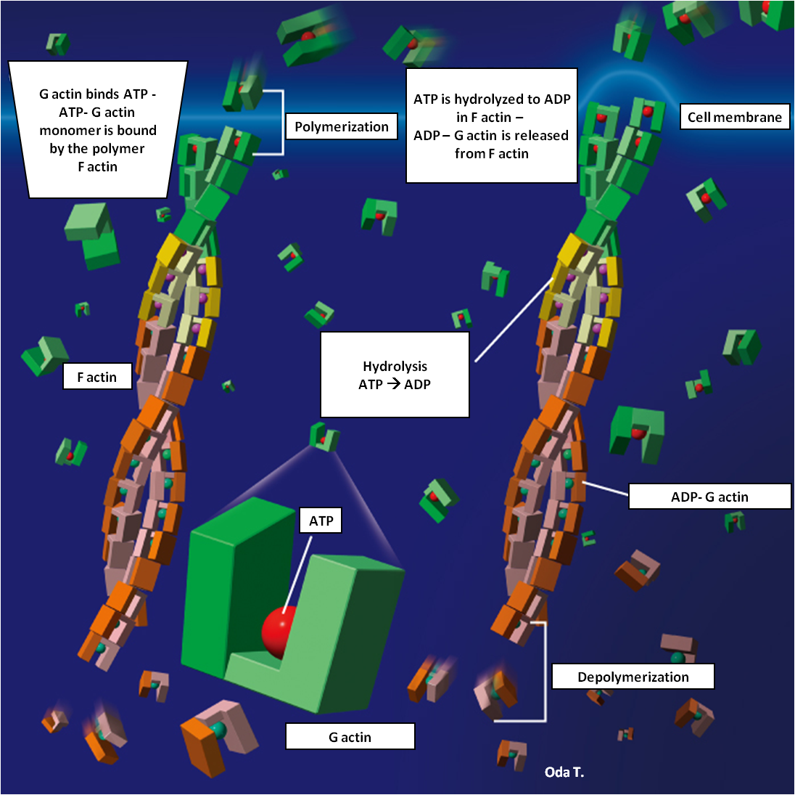
Actin polymerization
Polymerization:
ATP dependent
slow

Slide 28
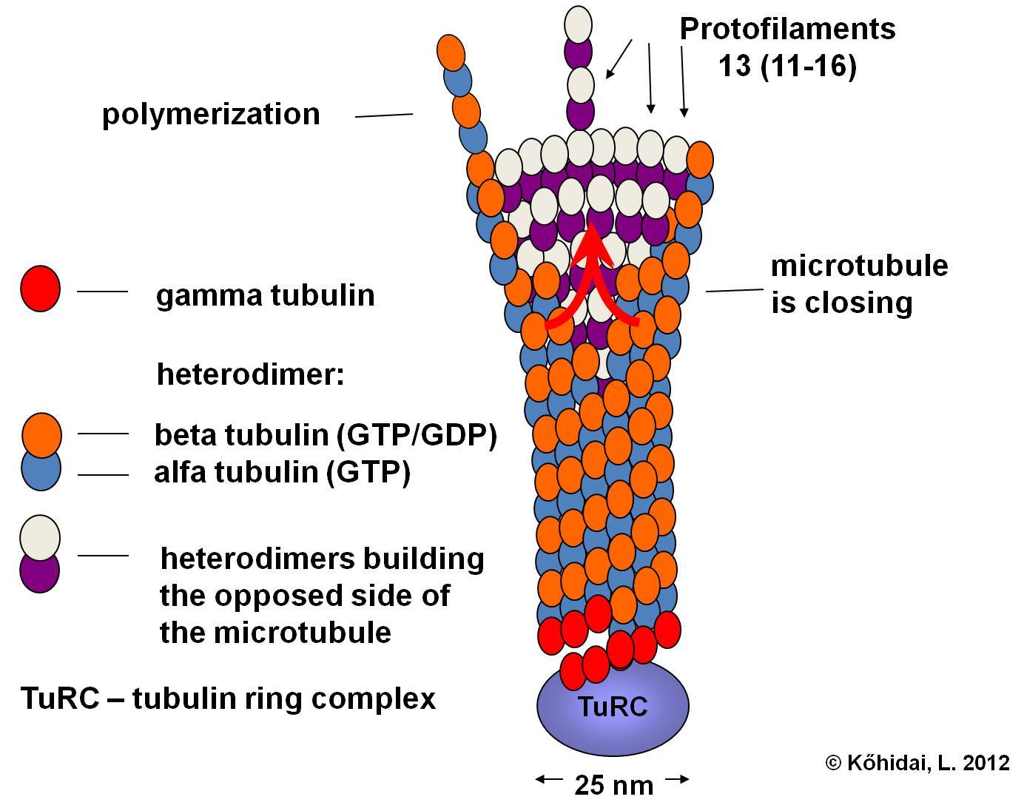
Microtubule Polymerization of tubulins
Polymerization:
GTP dependent
fast

Slide 29
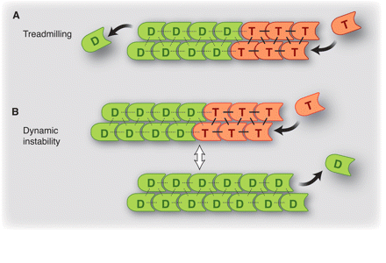
Models of structural instability
Treadmilling
model
Dynamic
instability
model
Treadmilling model considers the changing balance between the polymerization and depolymerization of the cytoskeletal component.
The dynamic instability model considers the polymerization or depolymerization of the same pole of the cytoskeletal component.
Notes:
Essential
definició

Slide 30
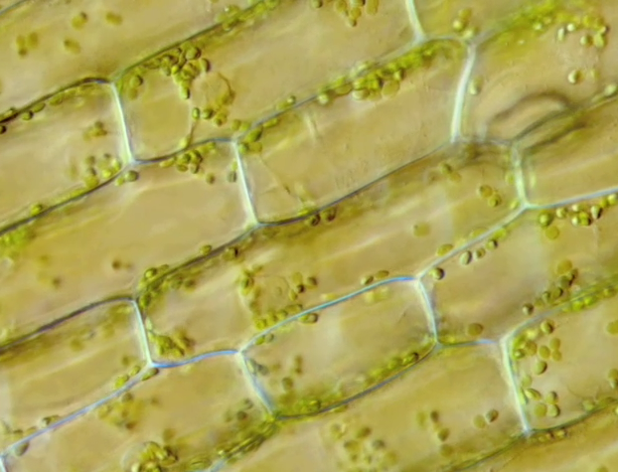

Slide 31
Cyclosis
Immobile
cytoplasm
Circulating,
cortical
cytoplasm
Surface membrane
Actin filaments
Cell wall
Motor proteines
Chloroplasts
Forrás: Lodish, H. et al. Mol. Cell Biol. 2000
Essential form of cellular movement.
In diatomes cyclosis of the cortical cytoplasm helps the movement of the cells.
- Sliding between motor proteins anchored to organels and cortical actin.

Slide 32
!
Monopodium
„hyalin-cap”
receptor
Lobopodium
„fountain”
mechanizmus
Polypodium
„hopper”
Reticulopodium
actin
network
stress-fibrills
integrins
© Kohidai, L. 2012
Notes:
Focal contact

Slide 33
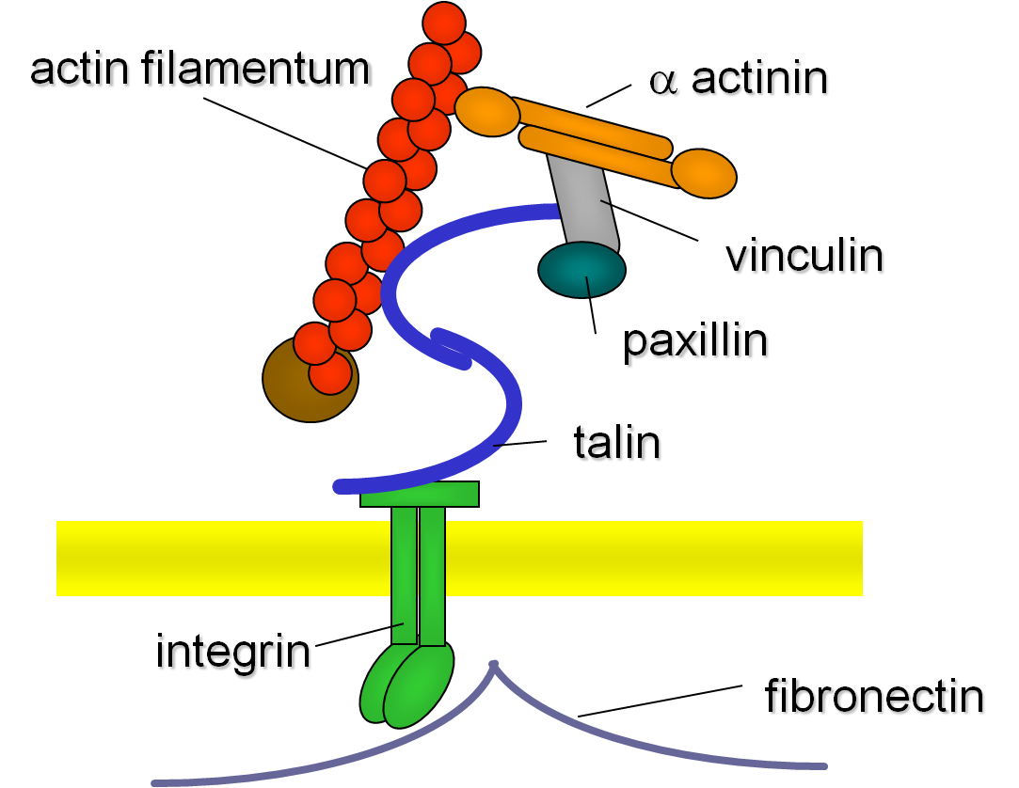
Focal contact

Slide 34
Actin associated
proteines
contractil bundle
α actinin - stress fibr.
gel-like network
filamin - cortex
„tight” parallel bundle
fimbrin - filopodium

Slide 35
Length of actin – regulatory proteins
Gelsolin
Severin
gCap39
CapZ
Villin
Tropomodulin
-
+

Cofilin
Severin
Gelsolin
Cytoplasmic regulatory proteins of actin influence length of the molecule:
Capping proteins can block growing or breakdown
other truncating proteins reduce acting length of actin in the cortex
Notes:
cím

Slide 36
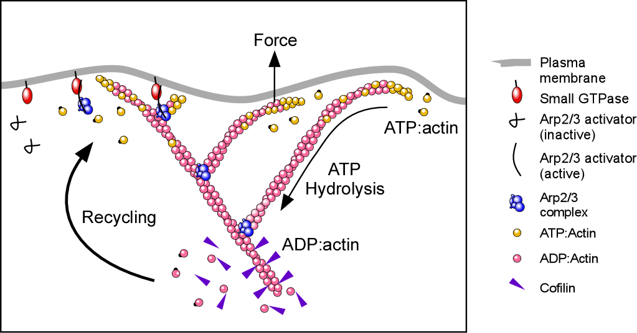
A Force generation onto surface membrane

Slide 37
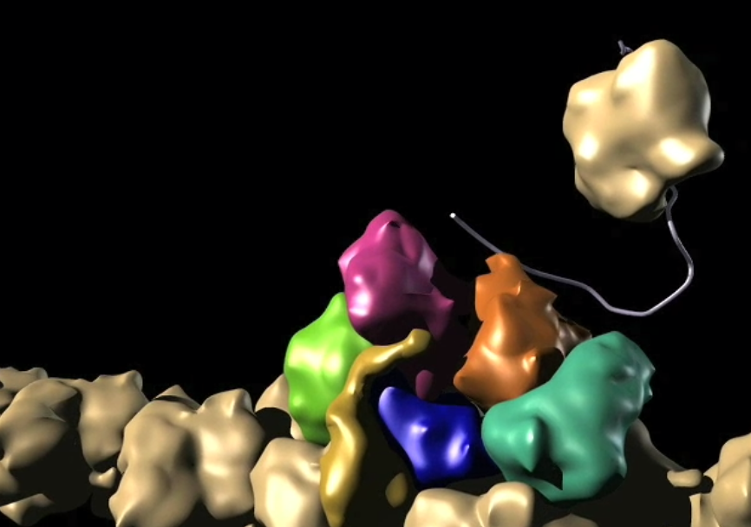
G-actin
Arp 2/3
complex
F-actin

Slide 38
Force generation by actin
Cell membrane
Myosin I.
Arp2/3
branching actin
Profilin
- G-actin
Protein
rich in
Pro
F-Actin
PIP2
Filamin
Integrin
F-actin generates force via different membrane conponents as Myosin I, PIP2 and integrins.
Connecting molecules: Arp2/3, profilin and filamin.
(Svitkina, TM és mts. J. Cell Biol. 1999 munkája felhasználásával
Notes:
cím

Slide 39
Mechanical strength given by intermedier filaments
desmoplakin
desmoglobin
cadherin
desmosome
Intermedier filaments influence position, polarity and shape of migrating cells in tissues.
keratin e.g. in epithelial cell
plectin
integrin
hemidesmosome
membrana basalis
© Kőhidai, L. 2012

Slide 40
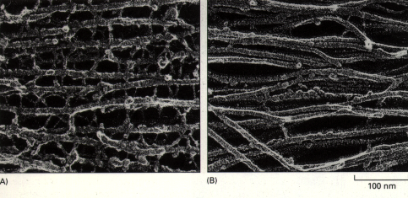
Intermedier filaments
Neuro-filaments
– several cross-linkers
Glial filaments
– few cross-linkers
Number of cross-linkers is diverse up to the type of the
intermedier filament

Slide 41
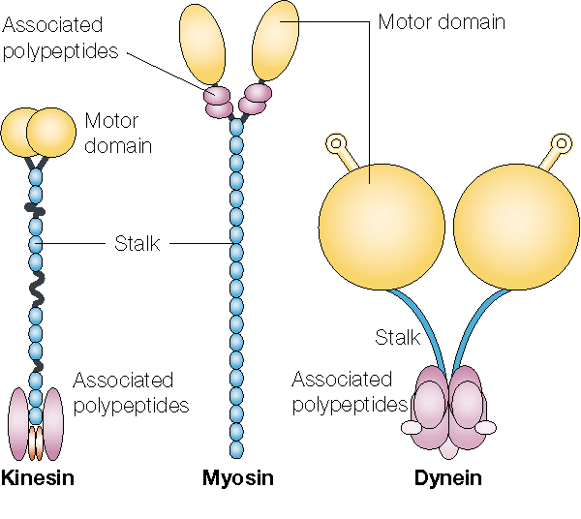
Motor proteins
!
assoc.
polypeptides
motor domain
motor
domain
„stalk”
„stalk”
assoc.
polypeptides
assoc.
polypeptides
Kinesin
Myosin
Dynein
Partner mol.: Tubulin Actin Tubulin

Slide 42
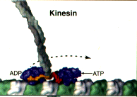
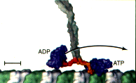
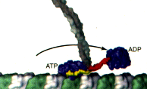
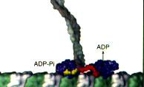
Kinesin „walking” on microtubule
Kinesin
ADP
ATP
ATP – strong interaction
ADP – weak interaction
ADP
ADP
ATP
ATP
ADP
ADP-Pi
https://www.youtube.com/watch?v=YAva4g3Pk6k

Slide 43
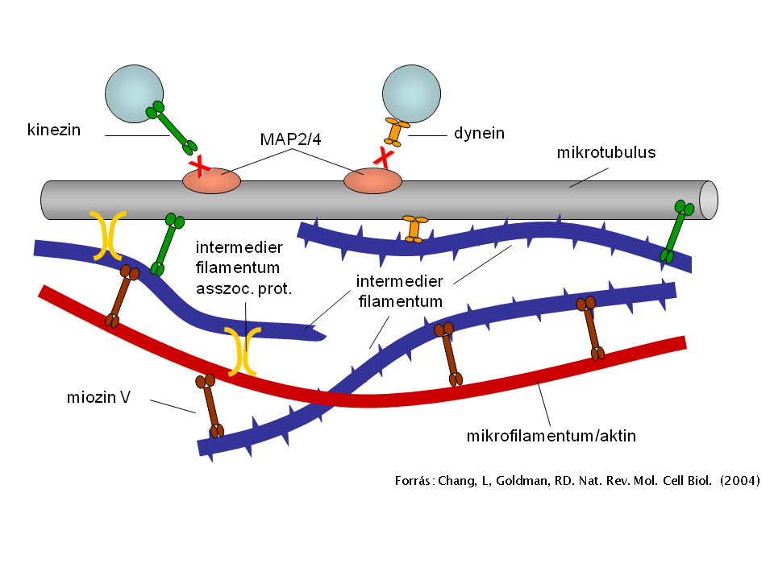
Actin - Intermedier filament – Microtubule
links
kinesin
microtubule
microtubule
intermedier filament assoc. prot.
intermedier filament
myosine V
microfilament/actin
Intermedier filaments are linkers between microtubular and microfilamentar system

Slide 44
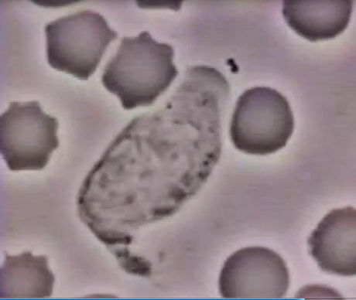
Molecules eliciting cell migration
Signaling

Slide 45
!
Chemoattractant substances
Chemorepellent substance

Slide 46
!
Main groups of chemoattractant ligands
ions of inorganic salts (K⁺, Cl⁻)
amino acids (methionine, serine)
biogenic amines
oligopeptides (bacterial tripeptides – e.g. fMLF)
hormones (insulin)
chemokines (e.g. interleukin 8)
pheromones
synthetic substances (drugs)

Slide 47
Sequence of appearence of amino acids in the primordial soup
and their chemotactic effects
Chemotactic responsiveness proved to be decisive in early levels of cell phylogeny.

Slide 48
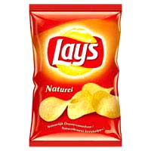
?
CHIPS = chemotaxis inhibitory protein of Staphylococci
CHIPS =
C5a receptor
CHIPS
Neutrofil gr.c.
C5a
Bacterium
CHIPS
Formyl peptid
receptor
fMLF
Receptors of C5a, fMLF are inhibited
Neutrofil grc. responses are blocked
Bacteria survive in human body
Forrás: Foster TJ. Nature Reviews Microbiology 2005

Slide 49
CHIPS are multipotent inhibitors.
The same CHIPS can block fMLF and C5a receptors
CHIPS
CHIPS
-NH₂
-NH₂
Formyl-peptid
receptor
C5a
receptor
-COOH
-COOH
Forrás: Foster TJ. Nature Reviews Microbiology 2005

Slide 50
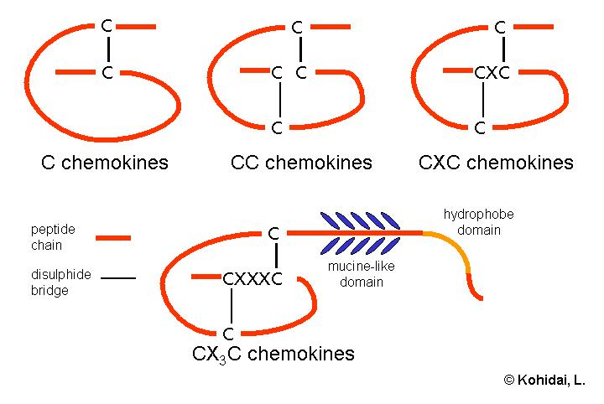
Classification of chemokines
!
C chemokines
CC chemokines
CXC chemokines
hydrophobe
domain
Peptide chain
disulfide-
bound
mucin-like
domain
CX₃C chemokines
Group of molecules responsible for migration in several motile cells of the body ( neutrophil grc., monocyte, lymphocyte).
Class CX3C is responsible for haptotactic responses as it has hydrophobe domain which can fix the molecule to the surface membranes.

Slide 51
3D structure of chemokines - Interleukin-8
© Kohidai, L. 2000
3D structure of IL-8, one of the most effective CXC chemokines.
The structure is composed of 3 beta sheets and an alpha helix and the connecting loops.

Slide 52
Chemokine receptors
!
chemokine
NH2-
GAG
receptor
Cellular and Molecular Immunology 1999
HOOC-
phosphorylation
G-protein
Interaction between chemokine and its receptor: it is shown that only some parts of the chemokine participate in the interaction and that chemokine develops contact with other membrane components (e.g. GAG)
Phosphorylation of the intracellular C-terminal part and induction of G-proteins are significant parts of intracellular signaling.

Slide 53
Mechanotaxis

Slide 54
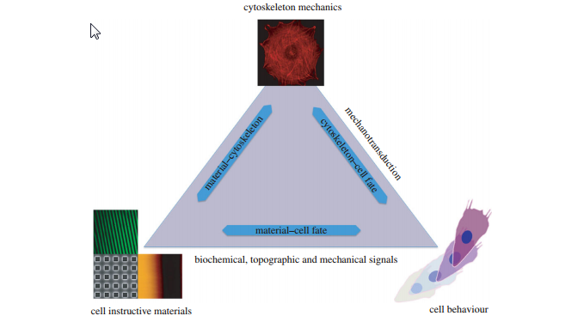
Cytoskeleton has a significant role in mechanotaxis
cytoskeleton
cell, its cytoskeleton and surrounding materials perform significant system
changing condition of environment has significant effect on migratory behaviour of cells
material - cytoskeleton
mechanotransduction
cytoskeleton - response
material - response
biochemical, topographical
and mechanical signals
cell instructive materials
cellular response

Slide 55
!
Preferences of migratory cell
Cell Rear
Lower density of adhesion proteins
Anterograde flow of F-actin
Leading Edge
Higher density of adhesion proteins
Retrograde flow of F-actin
Hard substrate
Larger resistive force
per adhesion molecule
Soft substrate
Smaller resistive force
per adhesion molecule

Slide 56
Clinical approaches

Slide 57
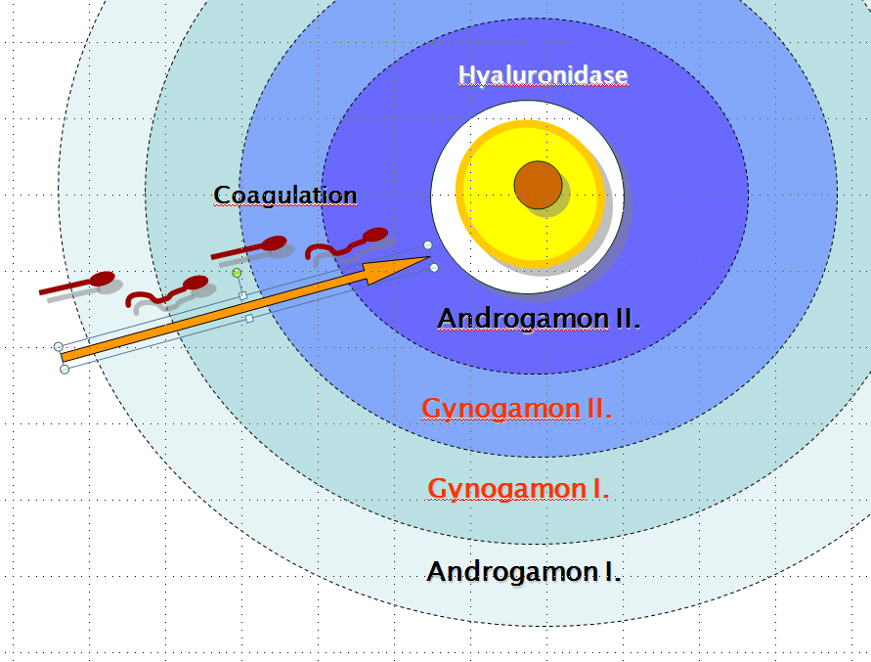
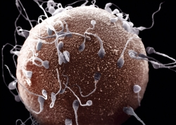
!
Fertilization: Chemotaxis as guiding factor
Male and female origin factors are present in the proximity of oocyte.
The cascade like process results also a positive selection of spermiums.

Slide 58
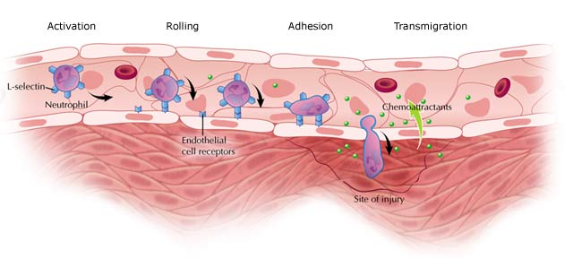
Inflammation - Transmigration
!
Interacting cells change expressed molecules (adhesion molecules – e.g. selectins, integrins and their receptors) on the surface step-by-step

Slide 59
Significance of chemokines in development of diseases
In the background of several serious diseases we can find inflammatory processes regulated by chemokines.
Every group of diseases is characterized by specific chemokine-target cell activation process.

Slide 60
Trapped macrophages - Atherosclerosis
monocyte
in blood
‘rolling’
firm
adhesion
endothel
cells
MIGRATION
scavenger
receptors
A pathological signal induced macrophage migration is in the background of atherosclerosis. The macrophages crossing the endothel are trapped and as a result their phathological metabolic processes turn to foam cells. The mass of foam cells forms the well known plaques.
tunica
intima
macrophage
differentiation
tunica
media
Nature Medicine 8, 1235 - 1242 (2002)

Slide 61
!
Tumor cells – Migration of metastatic cells 2
Matching of the chemokine receptors of the metastatic tumor cell and chemokine environment of the target tissue is a targeting factor in development of tumor metastasis.

Slide 62
Treatment with targeting of migratory cells
Dentures of maxilla/mandibula with scaffold filled chemoattractant
substance (PDGF)
Increased migration and proliferation of osteoblasts, fibroblasts and cementoblasts
promotes the ossification

Slide 63
Cellular movement and mechano-transduction:
Cell movement, its significance in biology and in medicine.
Main types of cell movement: taxis and kinesis (chemotaxis, haptotaxis and necrotaxis).
Main groups of substances with cell motility inducer ability (formyl peptides chemokines) and their receptors.
Structure and function of cilia and flagellum. Basal body.
Molecular mechanism of ciliary movement (sliding of microtubules). Amoeboid movement.
Differences in tissue elasticity.
Characteristics of the mechanical property of the migrating cell, preferences of cells.
(ECB: 569 – 604 OR 565 - 598)

Slide 64
Appendix
Information on the next slides are only to guide students about the subjetc, they do not belong to the core subjects of Cell Science.

Slide 65
Models of chemotactic signaling: Yeast
Induction of chemotaxis receptors results more responses via activation different intracellular pathways.

Slide 66
Models of chemotactic signaling : Dictyostelium
Crosstalk between ligands inducing
different signaling pathways can result also chemotactic responses.

Slide 67
Changing number of actin
filaments - induced by
cAMP treatment
in Dictyostelium
Chemotaxis
Two-peak response.
Reorganization of actin network.
+cAMP

Slide 68
Formyl-Met-Leu-Phe (fMLF)
fMLF
Chemotactic effects of the bacterial tripeptide (fMLF) is elicited via surface membrane receptors (FPR) composed by 7 transmembrane domains. Special parts of the receptor are responsible for binding of the peptide (red, brown), other parts (15AA loop) is responsible for the signal transfer into the cell.

Slide 69
Intracellular signaling network of Formyl-Met-Leu-Phe (fMLF)
Signaling via FPR is achieved by activation of different signaling pathways.

Slide 70
Complement system - C5a receptor
Receptor of complement C5a is also a 7TM structure. Its extracellular loops (red) are binding C5a, while the intracellular 18AA and 16AA loops have a role in signal transfer.

Slide 71
Complement system - C5a
Complement 5a (C5a) is the most chemoattractant member of the complement system.
Its chemoattractant moiety is elicited by the C-terminal pentapeptide (red) while other parts are responsible for the optimal conformation.

Slide 72
Ligandspecificity – Overlapping effect of chemokines
The same chemokine acts on different receptors
Possibility of regulatory networks and fine tuning of responses

Slide 73
Diversity of cellular responses induced by chemokines
- Induction of a chemokine receptor
results diverse functional responses
- Responses are chemotaxis related, while others have more general significance
U73122
Wortmannin
FUNCTIONAL RESPONSES
Formation uropodium
Anti HIV infection effect
Chemotaxis
IL-2 receptor expr.
Adh. mol. expr.
Cytokine release
Proliferation

Slide 74
Preferences of migratory cell – Tissues of the human body
Cells belonging to different tissues express diverse mechanical preferences.

Slide 75
Membrane level regulation of flagellar beating of sperm
Receptor-ligand interaction induced cascade
results hyper- and depolarization and consecutive
asymmetry of flagellum .

Slide 76
Chemotaxis as significant factor - Inflammation
calor - rubor - tumor - dolor + functio laesa
Celsus
(Kr.e. 3０～Kr. u ３８)
Virchow
(1821-1902)

Slide 77
Dual regulation of interaction between
vascular endothel and neutrofil grc.
Connection between vascular endothel and neutrophil grc. is regulated on two mechanisms by tumor necrosis factor (TNF):
Influences release of complement 5a (C5a) in neutrophil grc.
Induces expression of new receptors on endothel by interleukin-1 (IL-1) synthesis in endothel.
TNF = tumor necrosis factor
C5a = complement 5a
IL-1 = interleukin 1

Slide 78
Infections: Chemotaxis and cholera
Development of some infections (e.g. cholera) depends on the chemotactic ability (or the lack of it) of the microbe.

Slide 79
Tumor cells
Tumor cells express diverse adhesion and migratory responses in the primary and in the metastatic tumor.

Slide 80
Tumor cells – Migration of metastatic cells 1
In metastatic process the ratio of adhesion and migratory character of the tumor cell determines the release of the cell as well as its homing to the new tissue.

