Slide 1


Introduction to Human Genetics; The Human Genome
Genetics and genomics
07. 02. 2020.
Department of Genetics,
Cell- and Immunobiology
Semmelweis University

Slide 2
http://gsi.semmelweis.hu/
Login: student
Password: receptor
Notes:
RNA is involved in
Transcription/Translation: mRNA, tRNA, rRNA
Gene regulation: siRNA, microRNA
Splicing: snRNA
RNA degradation is necessary
Maturation of RNAs
Defective or non-functional RNAs
Control of gene expression
How can RNA be degraded?

Slide 3
Basic terms 1.
Genome: the complete genetic material of the cell
Genetics: science focusing on induvidual genes, the inheritence and variability
Genomics: science focusing on the entire genome and the interection of genes
Epigenetics: science focusing on inherited, however not DNA sequence encoded changes of gene expression

Slide 4
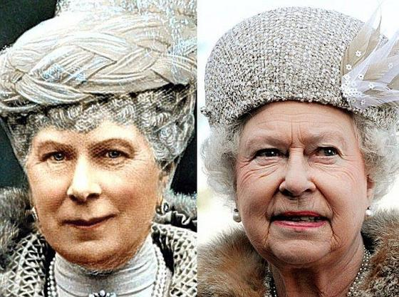
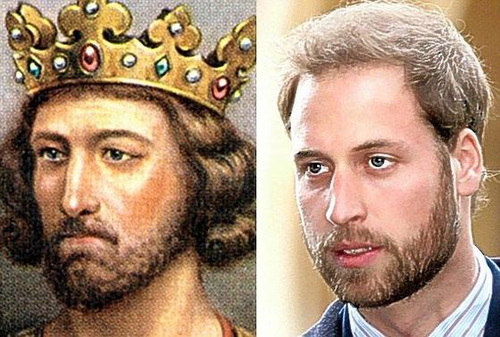
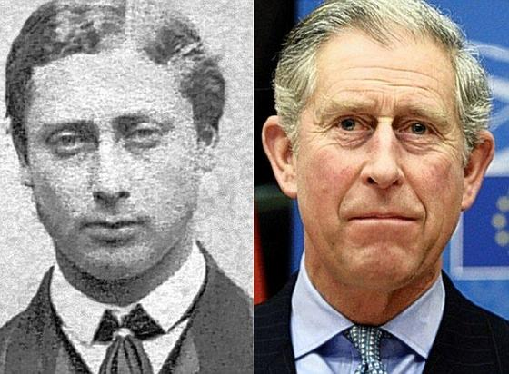
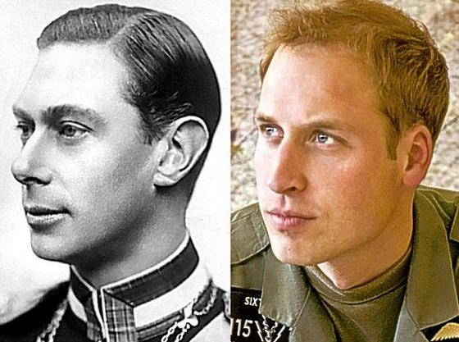
Inherited features
Mary (1867-1953), and granddaughter Queen Elizabeth II
King Edward I (1239-1307) anhis 21 td imes great-grandson Prince William
Edward VII (1841-1910) great-great-grandson Charles
King George VI (1895-1952) and great-grandson William
http://www.ivantic.net/Dejvid%20Ajk%20i%20zavere/kloirani%20gusteri.htm

Slide 5
Scope of Genetics
!
Stability
Inheritance
- of a trait (phenotype)
- constant chromosomal number
Variability
- Meiotic recombination
Crossover
Random assortment
- Fertilization
- Mutations / Polymorphisms
- Epigenetic variations
(from the Greek genno γεννώ= give birth)
is the science of genes,
heredity, and the
variation of organisms.

Slide 6
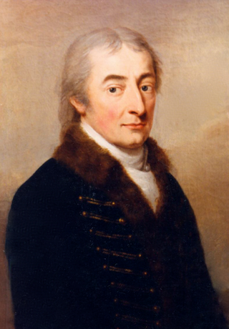
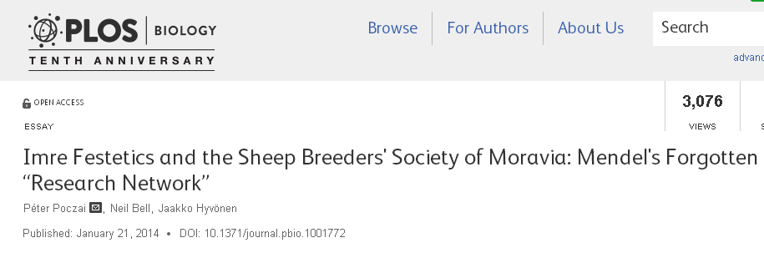
Count Imre Festetics – The Godfather
Festetics used the term “genetic” for the first time :
The genetic laws of nature: „Die genetische Gesätze der Natur,” 1819.
- Traits of grandparents that are different from those of the immediate progeny may reappear in later generations. (Same as Mendelian Rule of Segregation)
1764-1847
Notes:
Poczai P, Bell N, Hyvönen J (2014) Imre Festetics and the Sheep Breeders' Society of Moravia: Mendel's Forgotten “Research Network”. PLoS Biol 12(1): e1001772. doi:10.1371/journal.pbio.1001772

Slide 7
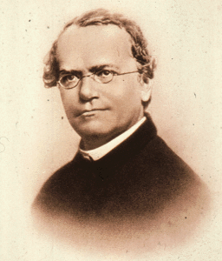
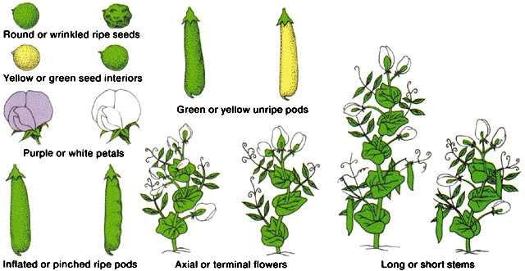
Beginning of Genetic science: Mendel investigated 7 pairs of characteristics
1822-1884

Slide 8

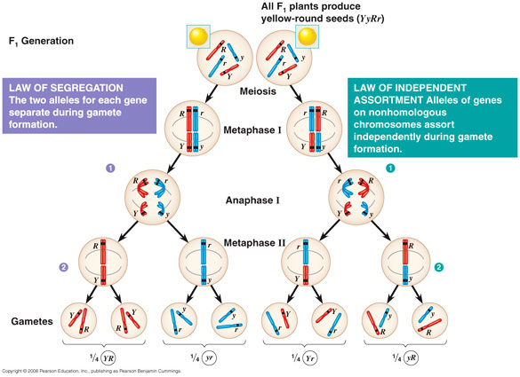
Mendel’s laws explained by the events during meiosis
Law of uniformity: F1 generation
after monoheterozygotic cross
Law of uniformity
1865

Slide 9
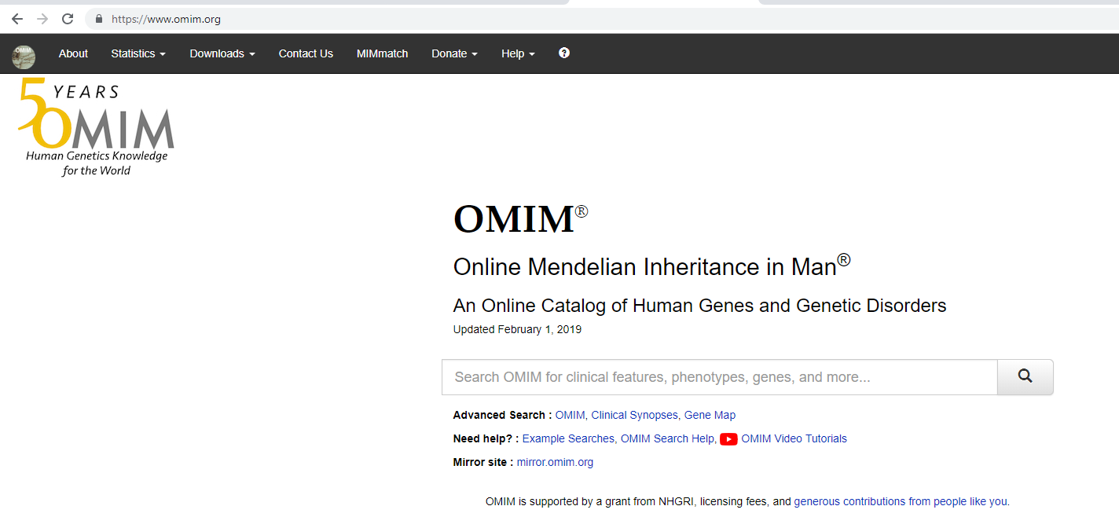
https://www.omim.org/statistics/geneMap

Slide 10
https://www.omim.org/statistics/entry
16037 known loci
Totaln ~ 24 000 human genes
~ 9 000 monogenic human genetic diseases follow Mendelian inheritance
Much more hereditary disorders or disease’ predisposing factors
What causes the differences in numbers?
Not all loci and genes are known yet
Many diseases / traits are not defined by one gene = complex traits / diseases
Even different parts and defects of one particular gene may be responsible for different traits / diseases

Slide 11
Types of inheritance
MONOGENIC
OLYGOGENIC
POLYGENIC
Number
Frequency
Mendelian
Non-Mendelian

Slide 12

Vertical gene transfer = transfer of information from generation to generation
(from parent to offspring or from cell to daughter cells)
Horizontal gene transfer = transfer of information between same or different organisms within a generation (prokaryots and prokaryots or pro- and eukaryotes or eukaryotes and eukaryotes)

Slide 13
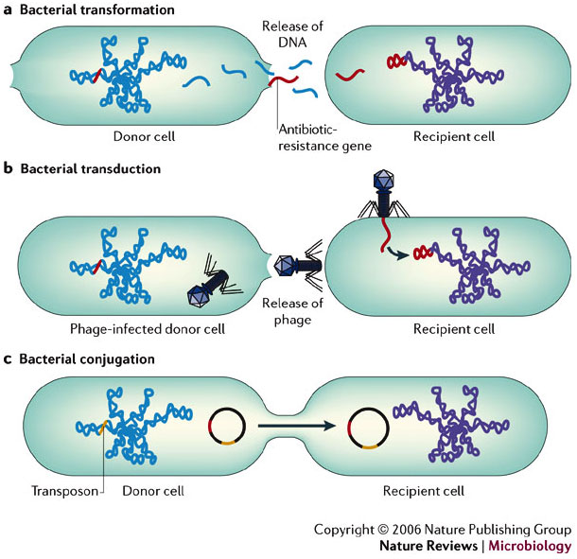
Horizontal gene transfer between bacteria
Bakteriális transzformáció
Bakteriális transzdukció
Bakteriális konjugáció
Furuya EY and Lowy F (2006) Antimicrobial-resistant bacteria in the community setting
Nat Rev Microbiol. 4: 36–45
Notes:
a | Transformation occurs when naked DNA is released on lysis of an organism and is taken up by another organism. The antibiotic-resistance gene can be integrated into the chromosome or plasmid of the recipient cell. b | In transduction, antibiotic-resistance genes are transferred from one bacterium to another by means of bacteriophages and can be integrated into the chromosome of the recipient cell (lysogeny). c | Conjugation occurs by direct contact between two bacteria: plasmids form a mating bridge across the bacteria and DNA is exchanged, which can result in acquisition of antibiotic-resistance genes by the recipient cell. Transposons are sequences of DNA that carry their own recombination enzymes that allow for transposition from one location to another; transposons can also carry antibiotic-resistance genes.

Slide 14
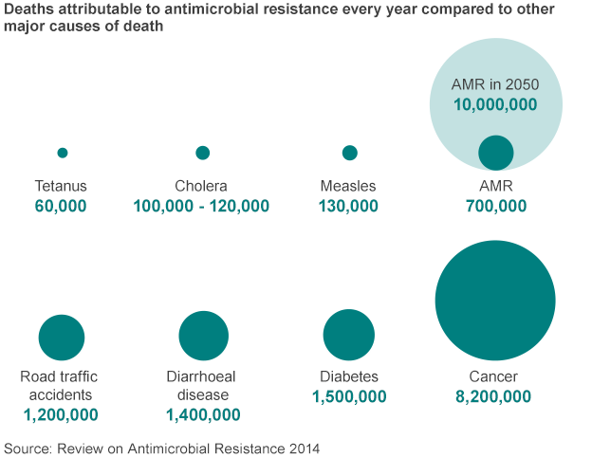
Mortality attributed to antimicrobial resistance

Slide 15
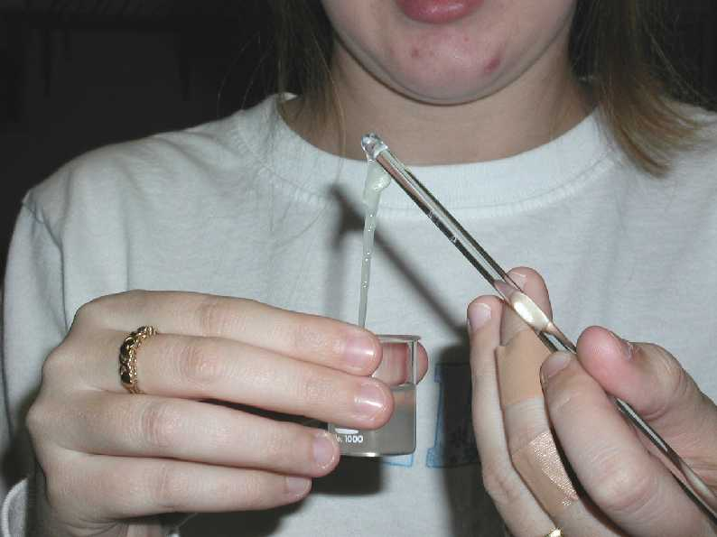
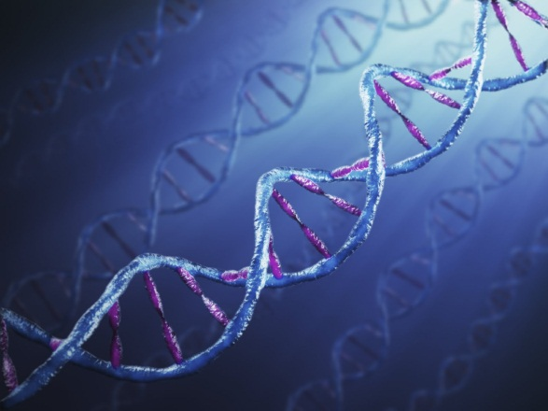
The genetic material: DNA

Slide 16
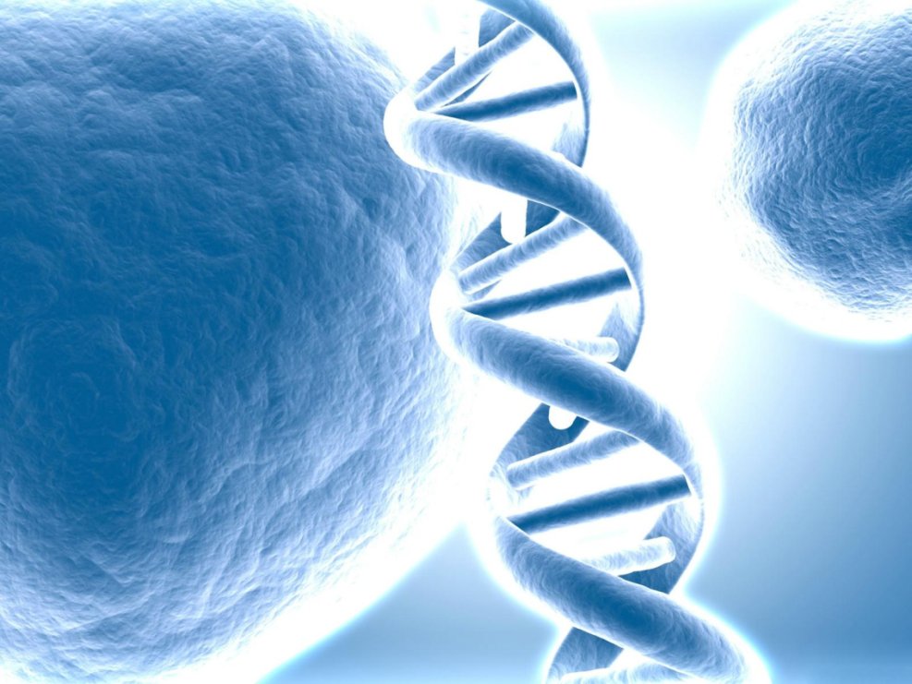
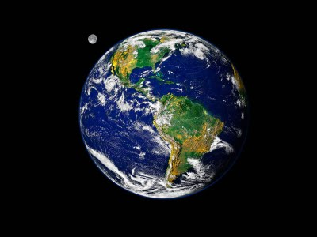
The length of DNA
In our body the DNA is 651 times longer than the distance of the Earth and the Moon
2 m / cell nucleus

Slide 17
Do all the cells of our body contain the same amount of DNA?
Somatic cells and germ cells differ
In somatic cells it also depends on the presence and number of nuclei (e.g. RBC, skeletal muscle cell)
Somatic cells also differ because of different stages of the cell cycle

Slide 18
Is the DNA sequence identical in all somatic cells?
No, in T cells and B cells it is different (somatic gene rearrangement)

Slide 19
What does the DNA encode for?
RNAs and proteins
Lipids and carbohydrates are non-templated

Slide 20
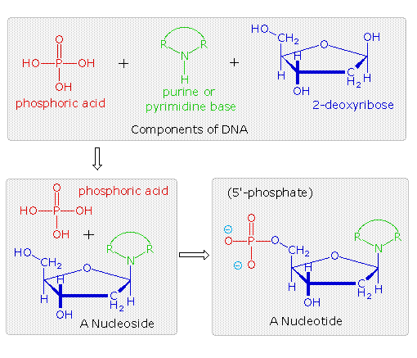
Building block s of DNA
nucleoside
nucleotide

Slide 21
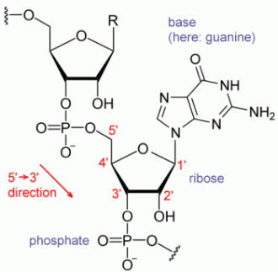
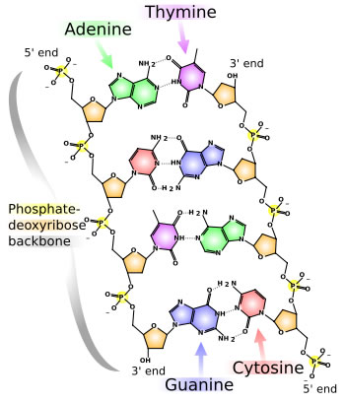
DNA
5’
3’
2x 3x10⁹ base pairs/human somatic cells

Slide 22
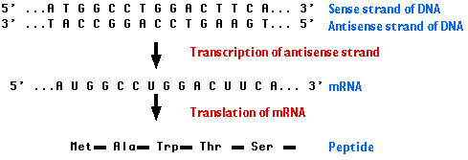
DNA
The antisense or nonsense or non-coding strand: it is the active strand that participates in transcription of sense (5’AUG …3’) mRNA.
Single strands are written by convention 5’-3’.

Slide 23
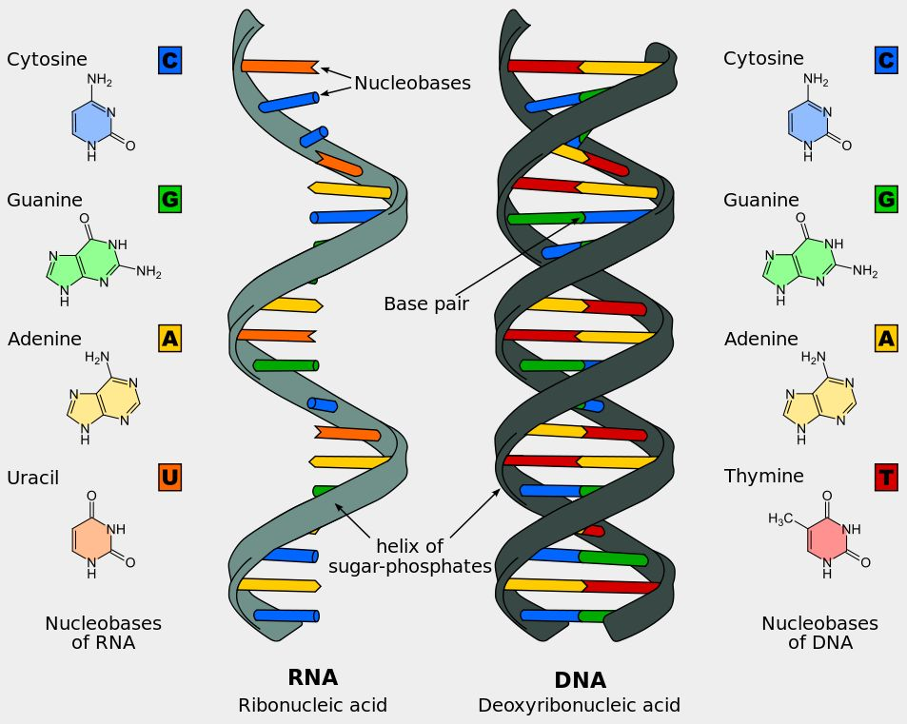
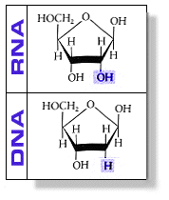
RNA and DNA

Slide 24
What can we tell by the sequences?

Slide 25
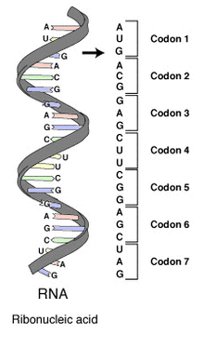
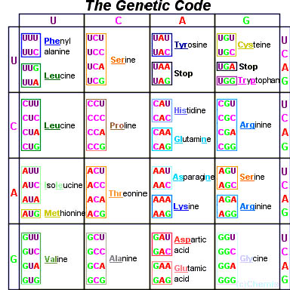
Transcription followed by translation based on the genetic code
!
Features of the genetic code
1. Three letter code (triplets)
2. Redundancy - Wobbling
One aa may be coded by several triplets
(20 aa – 61 triplets)
3 stop codon (TAA, TAG, TGA)
3. Comma-free, Non-overlapping
4. Almost universal
5. No ambiguity (1 codon encodes for 1 amino acid only)

Slide 26
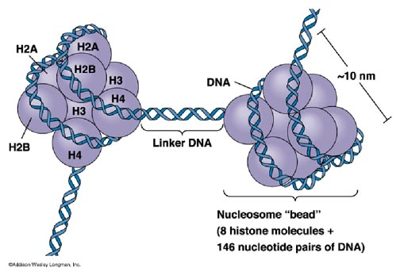
The nucleosoal organization of the DNA
Notes:
RNA is involved in
Transcription/Translation: mRNA, tRNA, rRNA
Gene regulation: siRNA, microRNA
Splicing: snRNA
RNA degradation is necessary
Maturation of RNAs
Defective or non-functional RNAs
Control of gene expression
How can RNA be degraded?

Slide 27
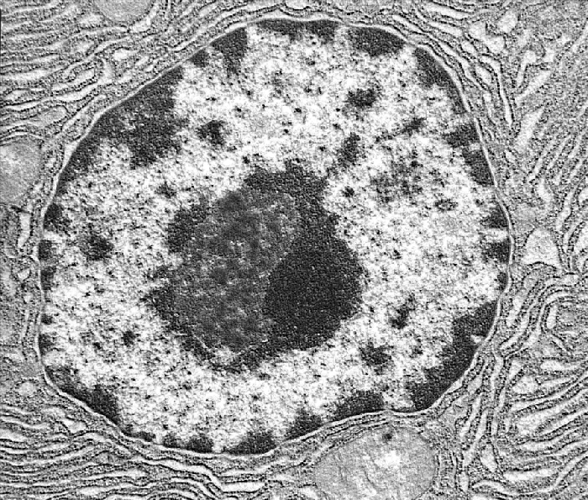
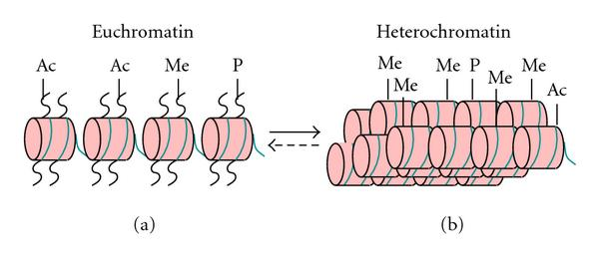
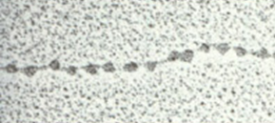
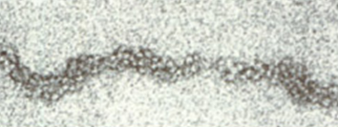
The chromatin
euchromatin
heterochromatin
Uncoiled chromatin filament with nucleosomes: „genes on”: active
Interphase chromatin filament: „genes off”: inactive (30 nm ∅)

Slide 28
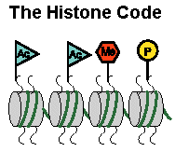
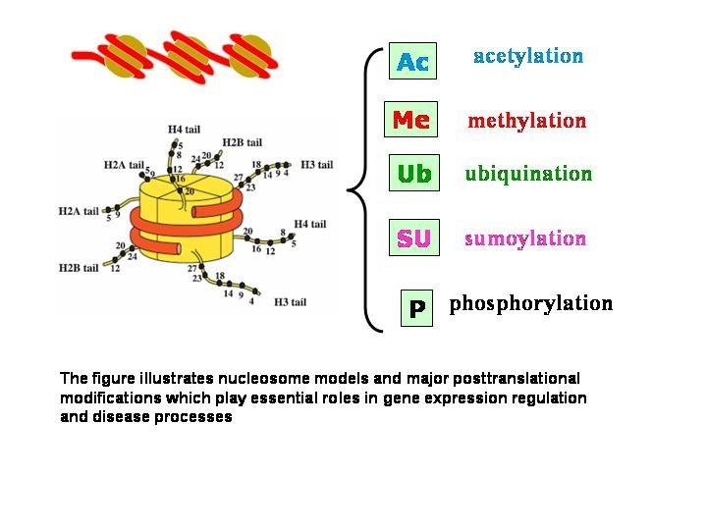
The histone code (chemical modification of histones) regulates the chromatin packing and gene transcription
!
AC: acethylation
Me: methylation
P: phosphorylation
U: ubiquitylation

Slide 29
The formation of chromosomes
nucleosome
DNA shortens to 1/7 - 11nm in diameter.
solenoid: 30 nm
looped structure
100 kb
condensed section of a chromosome : 1 Mb
Chromosome: 10 000-fold shorter

Slide 30
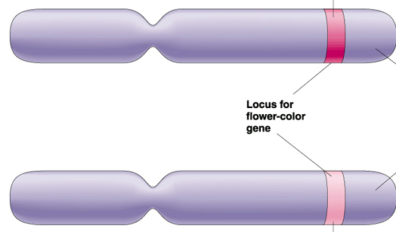
Basic terms 2.
Gene:
  the unit of inheritance, part of the DNA or RNA
Locus:
  location of a given gene on a chromosome
Gene product:
  RNA
  Protein
Allele:
(allelomorph genes)lok)
    Gene variant at a given locus
    gene variant at a given locus
Wild type allele: the most frequent variant of a given gene in nature

Slide 31
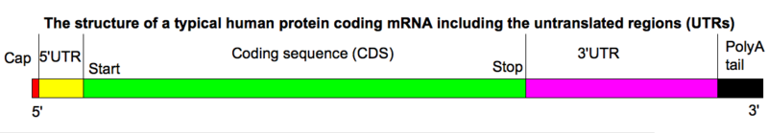
Structure of the eukaryotic protein coding gene
!
UTR (untranslated region) =
= UTR + polyadenyl. site
Structure of mRNA

Slide 32
Basic terms 3
Genotype: genetic composition of characteristics for an individual or a locus
Phenotype: Measurable and observable features of a cell or and individual

Slide 33
Correlation of Genotype – Phenotype
Phenocopy – trait which is caused by environmental conditions, that matches a phenotype which is determined by genetic factors.

Slide 34
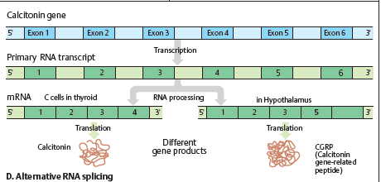
Alternative splicing

Slide 35
Inheritance versus environmental effects
!
Environment
Eco-
genetic*
Major genes
Monogenic
Mendelian
Multifactorial/ Complex
Minor genes
Polygenic
* including pharmacogenetics, nutrigenetics

Slide 36
Basic terms 4
Homozygote: identical alleles at the same loci of the chomosome pair
Heterozigote: different alleles at the same loci of the chomosome pair
Hemizigote: carries only a single copy of the gene
Dominant allele: a gene variant that phenotypically always results in a given chracateristics (even in heterozygotes)
Recessive allele: a gene variant that manifests phenotypically in homo- and hemizygotes only
Possible genotypes: AA, Aa, aa

Slide 37
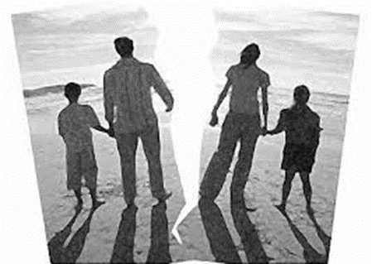
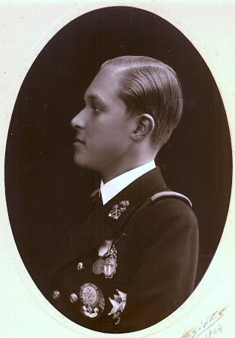
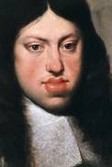
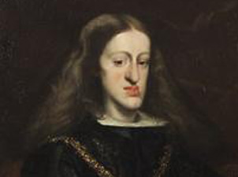
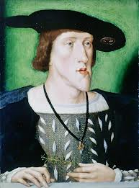
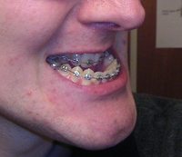
Special problems of humangenetics to study the inheritance
Small (nuclear) families, mosaic families
Technical (long life span of human)
Lack of long term and exact records
Except aristocrats/Royal families
e.g. Inheritance of Habsburgian lip – mandibular prognathism
Notes:
II. Károly
V. Károly
Asztúria hercege 1924

Slide 38
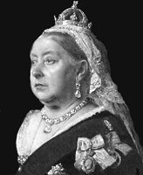
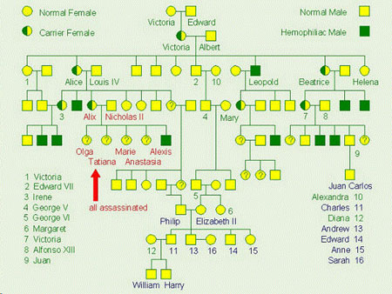
Royal hemophilia

Slide 39
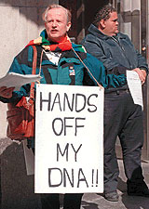
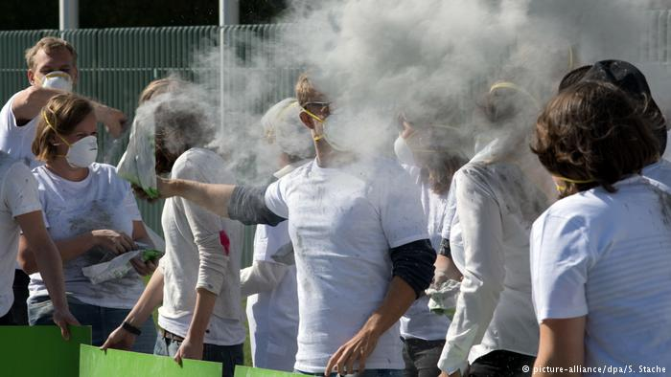
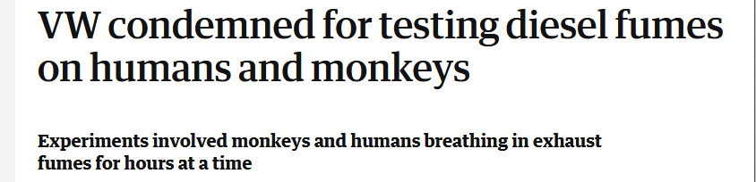
Special problems of humangenetics to study the inheritance
ELSI (Ethical, Legal, and Social Issues), gene ethics
The genome of the individual is the key to susceptibility to the disease
Forbidden and illegal human genetic experiments

Slide 40

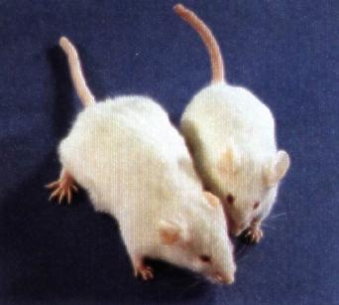
Methods of humangenetics : to understand the correlation between genotype and phenotype
Possibility to develop genetically modified organisms
Extrapolation of common/similar traits from animal studies
Humans:
Experimental animals:
Mutate the genotype and record the phenotype
Investigate the phenotype and record the genotype (statistics)

Slide 41
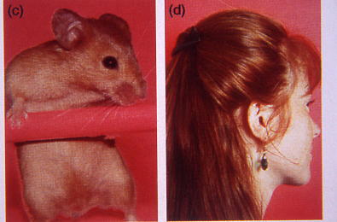
Methods of human genetics I.
Extrapolation of common/similar traits from animal studies
e.g. The same mutation of the same gene is responsible for red hair color and red fur

Slide 42
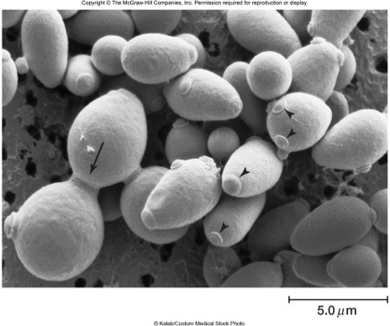
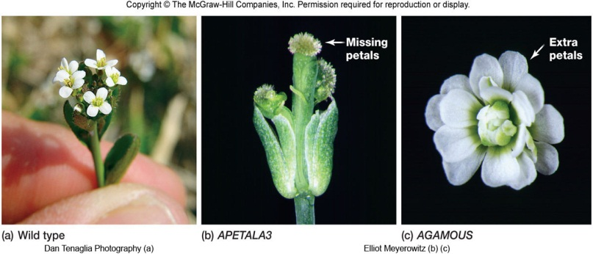
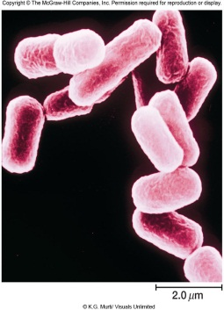




Short reproduction time, high offspring number made them valuable systems in genetics
E. coli
baker’s yeast
Arabidopsis thaliana
Drosophila
Caenorhabditis
Zebra fish
mouse

Slide 43


Methods of human genetics II.
!
Pedigree analyis
Twin studies

Slide 44

Methods of human genetics III. Population screening
!
People
Height

Slide 45
Relatively few genes, more RNA,
much more proteins and extremely high amount of small molecules interacting with all these .
Genome = the complete genetic material of the cell
Transcriptome = the total RNA content of the cell
Proteome = the total protein content of the cell
Metabolome = the total small molecule content of the cell

Slide 46
Classical Genetics
investigates the inheritance of one or few traits
Genomics
investigates the whole genome, the function, structure and interactions of the complete gene-set.
No definite difference between the two terms, even in the scientific usage, genetics and genomics are often interchangeable.

Slide 47





Human genomics investigate several levels
Cell
Nuclear genome
Gene
Cromosome
DNA
Person
Population
Family

Slide 48

The genome
the complete genetic material of the cell
Mitochondrial
Nuclear

Slide 49


The nuclear and mitochondrial genomes

Slide 50

Mitochondrial genome
16 569 basepairs,
37 genes

Slide 51

Several mitochondrial genes had been translocated to the nucleus
!

Slide 52

Organization of the nuclear genome

Slide 53

The structure of the human genome
(coding)
Mb (megabase): 1 million bases

Slide 54

The structure of the human genome
The function of the others?
Regulation of gene expression

Slide 55

The human haploid nuclear genome
consists of 3.3 x 10⁹ basepairs
!
Homo = 3 300 MBp
C-value enigma or C-value paradox:
Genome size does not correlate with organism’s complexity.
(C-value: haploid genome)
MB(p): megabase(pair), 10⁶ nucleotide (pairs)

Slide 56

!
Homo = 3200 MBp
May be the non-coding DNA is more important in the evolution?

Slide 57


Posttranslational modifications

Slide 58
PEOPLE ARE VERY SIMILAR
The genomes of two individuals show 99.8% identity. The ancestors coming out of Africa and inhabiting the Earth changed relatively little during the migration.

Slide 59

PEOPLE ARE VERY DIFFERENT
Between two people there are 3 million bp differences – every 1000nd bp are different.
Notes:
2018. 01. 27. 10:39
A férfi török, a nő indiai.

Slide 60
Interindividual nucleotide differences
Single nucleotide polymorphisms (SNPs)
>1% in the population

Slide 61
Single nucleotide variant (SNV)
A variation in a single nucleotide without any limitations of frequency.
It may arise in somatic cells (e.g., caused by cancer), also called a single-nucleotide alteration.

Slide 62
The structure of the human genome
(coding)
Mb (megabase): 1 million bases

Slide 63

Repetitive sequences in the genome

Slide 64



Transposons
Barbara McClintock
1983, Nobel prize
’cut and paste’ (class II)
DNA transposons
‘copy and paste’
(class I) retrotransposons

Slide 65

Human Genome Project
International research effort to determine the sequence of the human genome and to identify its genes.

Slide 66
What is the Human Genome Project?
From 1990 throug 13-year effort
Project goals were to
  identify all the approximately 20,000-25,000 genes in human DNA,
  determine the sequences of the 3 billion chemical base pairs that make up human DNA,
  store this information in databases,
  improve tools for data analysis,
  transfer related technologies to the private sector, and
  address the ethical, legal, and social issues (ELSI) that may arise from the project.
  What is for?

Slide 67
Inherited disease
Gene mapping
Gene identificaton
Time
Human Genome Project speeds up this process
Diagnostics
Understanding the biology of the disease
Preventive
medicine
Farmaco-
genomics
Proper
medication
Gene therapy

Slide 68

Era after HGP
http://www.nature.com/encode/

Slide 69

ENCODE
Encyclopedia of DNA Elements Project (2003-2012)
Major results:
Presumably a much larger proportion of the human DNA is active than what we thought previously:
The majority of the non-coding regions participate in regulation of the expression of the coding 1%

Slide 70

Human genome + Microbiome

Slide 71
Age of omics
!
The term ‘genomics’ also involves the special genomic methods and bioinformatics.
Genomics is part of the systems biology.
Several subtypes of genomics, e. g.
  structural genomics,
  comparative genomics,
  plant genomics,
  human genomics,
  pharmacogenomics - the study the interaction of genes and drugs
  Nutrigenomics (to study the interaction of genes and nutrition)
  etc.

Slide 72


Slide 73

The difference between the human and chimpanzee genomes is 4% only
Genome Res. 2005 Dec;15(12):1746-58.

Slide 74

Genetics influences on psychological well-being
>800 twins
Genes play a role in self-control, decision making, sociability, sense of purpose, how well to get on with people, and ability to continue learning and developing.
Archontaki D et al. Genetic influences on psychological well-being: a nationally representative twin study. 2013;81:221-30

Slide 75


Genetics influences political beliefs
Genetic information might be used to predict variations in political opinion more reliably than we can use genetic information to predict longevity and alcoholism.

Slide 76


Genetics and infidelity

Slide 77


Genetic basis of novelty seeking

Slide 78


Genetics impact your patients response to drugs

Slide 79



Genetics impact your patients response to drugs
Pharmacogenomics

Slide 80


Genetic analysis services are commonly available

