Slide 1
Genetic variability: Mutations and polymorphisms
Genetics and genomics
ED 28. February 2020.

Slide 2
Genetic variability
!
Increased by
- Sexual reproduction
meiosis (generation of gametes
homologous recombination (crossing over)
independent assortment of homologous
chromosomes
fertilization
- Mutation
Significance:
Without mutation, evolution would not be possible. It provides the "raw material" for natural selection.
Notes:
2

Slide 3
Sequence variants (allelic variants)
!
Mutation
A change in the nucleotide sequence
A source of genetic variability
Polymorphism
Coexistence (occurance) of different sequence variants within a population or species if we know its frequency
Mutation and polymorphism may be used as synonymous terms sometimes.

Slide 4
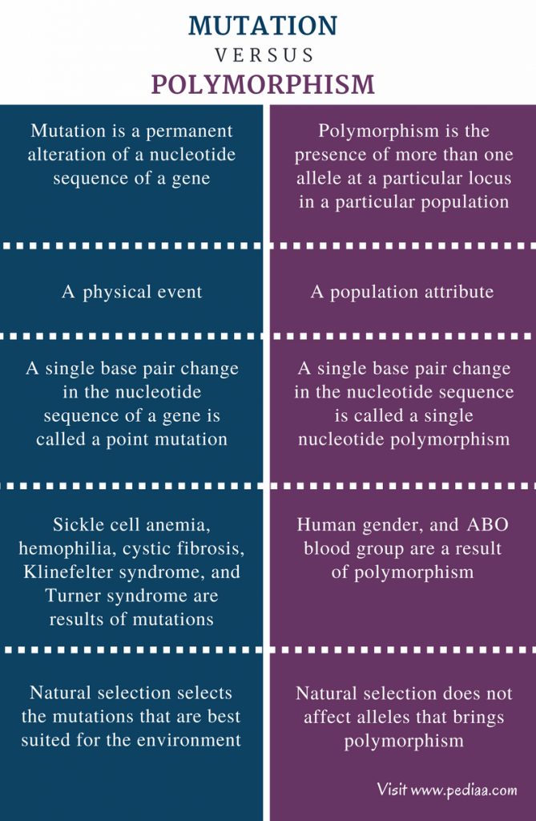
http://pediaa.com/difference-between-mutation-and-polymorphism/

Slide 5
Mutations can by classified by several ways
!
Size (small –medium –large)
Cause (spontaneeous ↔ induced)
Position (Site)
- In the genome (nuclear ↔ mitochondrial; coding ↔ non-coding)
- In the body (germ line ↔ somatic cells)
Inheritability (generative ↔ somatic)
Function
(loss of function ↔ gain of function ↔ neutral)
Fitness (pathogenic ↔ non pathogenic)

Slide 6
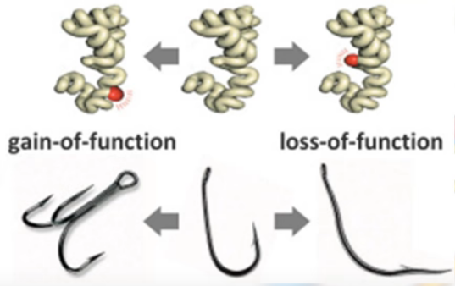
Consequences of mutations: Pathogenic mutations
!
Loss of function
E.g. Hemophilia
Lethal mutations are mutations that result perinatal death.
Sublethal: inability for reproduction
Gain of function
E.g. Huntington chorea

Slide 7
Consequences of mutations: Non-pathogenic mutations
!
Beneficial mutations
Back mutation
restores the wild type DNA sequence
Functional benefit
E.g. specific mutation in human CCR5 (CCR5-Δ32) confers HIV resistance
Sickle cell anemia – malaria resistance
Antibody diversity
Neutral mutations
No consequence at the given environment (but may be in altered conditions)

Slide 8
!
Inheritability of mutations
Temporary mutations (Not inherited)
DNA repair (99.9%)
DNA polymerase: self-correction
Generative mutations
In the germ line cell
They can be passed on to descendants
Somatic mutations
In somatic cells
They cannot be transmitted to descendants
Notes:
Post mortem mutation: non inheritable post mortem a(ncient)DNA mutation in decaying remains

Slide 9
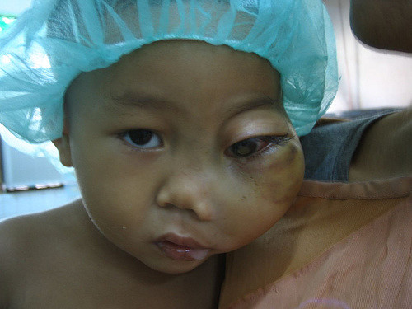
Somatic mutations may cause diseases, too (e.g. retinoblastoma)
!
Retinoblastoma (Rb) is a rare form of cancer . It is the most common primary malignant intraocular cancer in children, and it is almost exclusively found in young children.
Though most children survive this cancer, they may lose their vision in the affected eye(s) or need to have the eye removed.

Slide 10
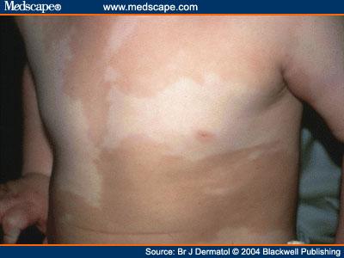
Consequence of somatic mutations called mosaicism
!
Occurrence of cells that differ in their genetic component from other cells of the body
The asymmetrical pigmentation due to a mutation in some but not all cells (somatic mosaicism).
Notes:
http://www.medscape.com/content/2004/00/49/38/493837/493837_fig.html

Slide 11
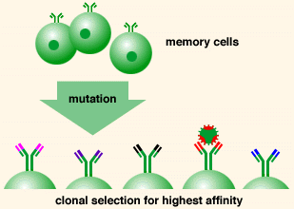
Somatic mutations are useful in the generation of antibody diversity
!
B-cells
antibody diversity

Slide 12
Estimated frequencies of mutations
CLASS OF MUTATION | MECHANISM | FREQUENCY (APPROXIMATE)
Genome mutation | Chromosome mis-segregation | 2-4 × 10⁻²/cell division
Chromosome mutation | Chromosome rearrangement | 6 × 10⁻⁴/cell division
Gene mutation | Base pair mutation | 10⁻¹⁰/base pair/cell division 10⁻⁵-10⁻⁶/locus/generation
Notes:
Based on Vogel F, Motulsky AG: Human Genetics, 3rd ed. Berlin, Springer-Verlag, 1997; and Crow JF: The origins, patterns and implications of human spontaneous mutation. Nat Rev Genet 1:40-47, 2000.

Slide 13
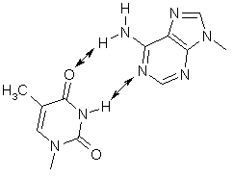
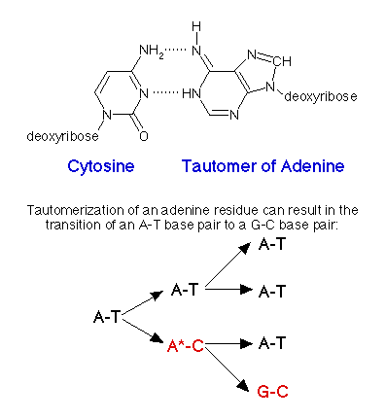
!
Causes of mutations
Spontaneous
Unwanted chemical reactions
Tautomerization ⇒
Depurination
Deamination
Errors of
Replication
Crossing over
Repair
„Hot spots”
CpG
repetitive sequences
T - A

Slide 14
Causes of (induced) mutations
!
Induced by environmental factors called mutagens
Physical
Radiation
Heat
Thermal hydrolysis
UV
Ionizing
X-ray
γ-ray
Radiotherapy
Chemical
Natural plant toxins
Human-made mutagenic chemicals
lab chemicals
environmental pollutants
chemotherapy

Slide 15
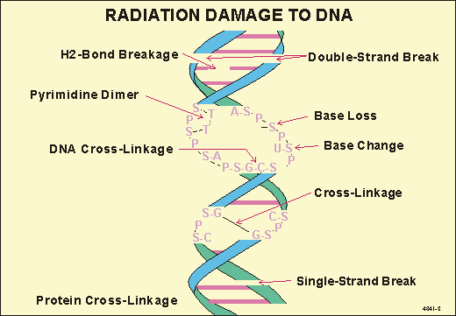
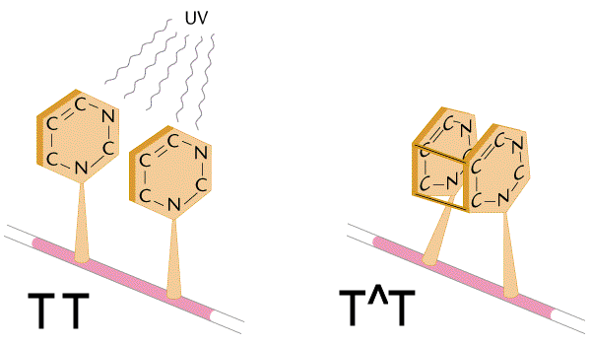
!

Slide 16
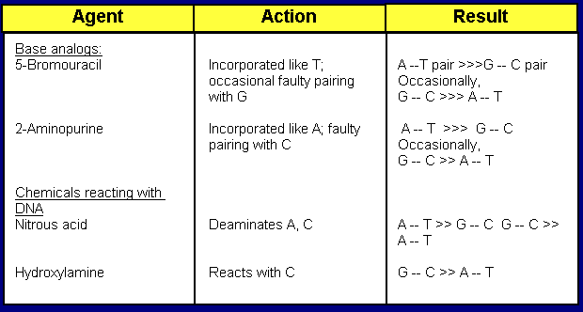
Chemical mutagens I-II.
!
Chemicals altering structure and pairing of bases

Slide 17
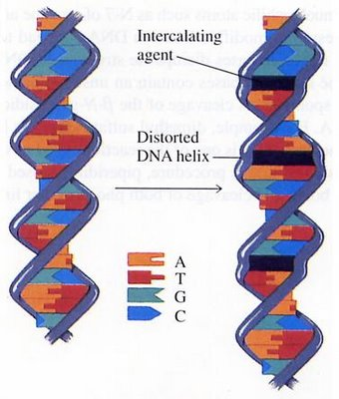
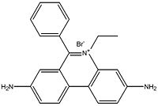
Chemical mutagens IV.
!
Intercalating agents
flat, multiple ring molecules inserting between the bases.
a "stretching" of the DNA duplex and the DNA polymerase is "fooled" into inserting an extra base opposite an intercalated molecule.
insertion, frameshifts.
ethidium bromide
Notes:
http://www-personal.k-state.edu/~bethmont/mutdes.html
http://sandwalk.blogspot.com/2007/07/ethidium-bromide-binds-to-dna.html

Slide 18
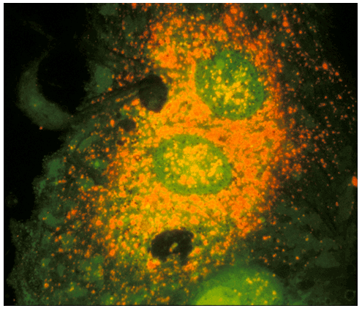
Intercalating lab chemicals
!
Ethidium bromide (see Molecular genetics practical lesson)
BrdU
(see Cytogenetics practical lessons)
A senescent endothelial cell stained with the fluorescent dye acridine orange to visualise the lysosomes.

Slide 19
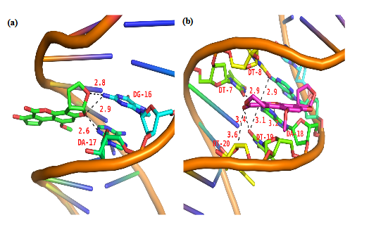
Intercalating natural mutagenes
!
aflatoxin
Intercalating aflatoxins are green (l) and pink (r)

Slide 20
Polycyclic aromatic hydrocarbons can be found in the cigarette smoke and exhausting gases
!

Slide 21
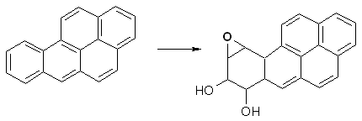
Air pollutant chemical mutagens
!
chemicals causing DNA strand breaks (e.g. peroxides)
Transformation of benzpyrene by mammalian liver enzymes produce an extremely mutagenic epoxide

Slide 22
DNA polymerase is a self-correcting enzyme
!
Notes:
www.uic.edu/classes/phar/phar331/lecture4/

Slide 23
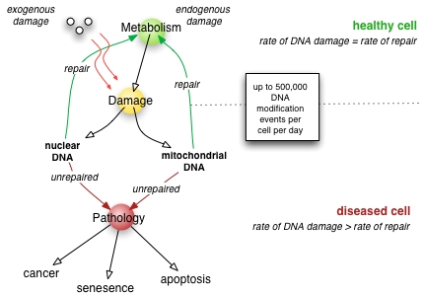
DNA repair
https://en.wikipedia.org/wiki/DNA_repair

Slide 24
DNA repair
Direct reversal
simplest; enzymatic action restores normal structure without breaking backbone
(e.g methyl group removal)
Damage removal
involves cutting out and replacing a damaged or inappropriate base or section of nucleotides
Single strand breaks
Double stand breaks
Notes:
http://www-personal.k-state.edu/~bethmont/mutdes.html

Slide 25
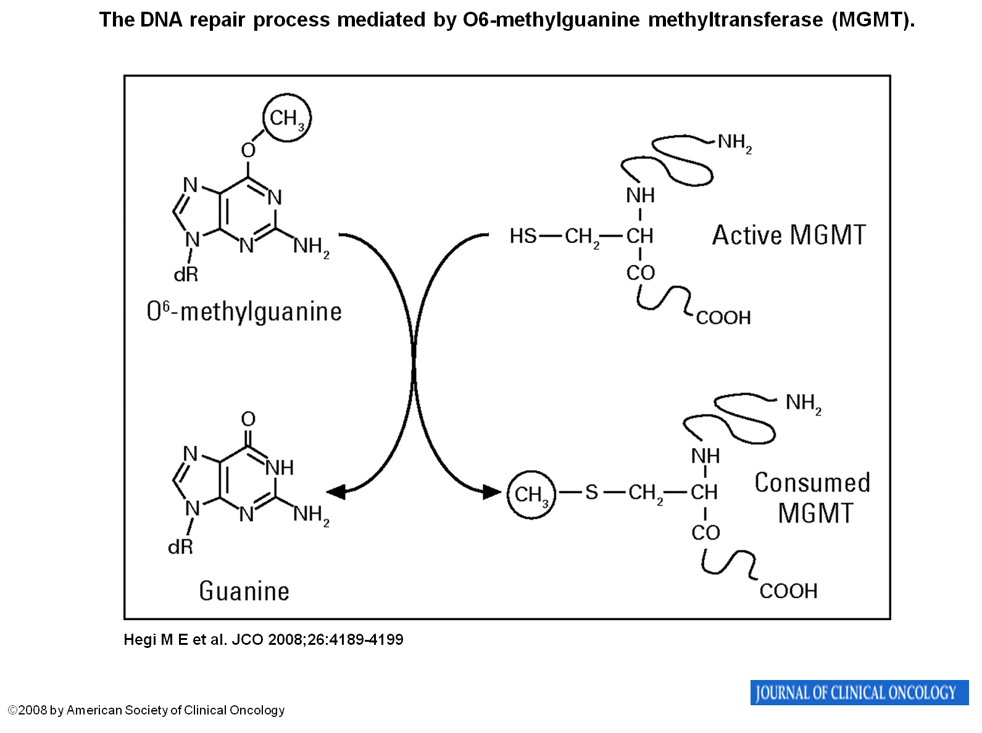
Direct Reversal: methyl group removal
!

Slide 26
Repair of single strand brakes (remember about the enzymes and disease association)
!

Slide 27
Repair of double strand brake (DSB) possible by homologous recombination (HR), or non-homologous recombination (NHEJ), but this may be the source of mutations
!
(b) Recombination between allelic sequences on homologous chromosomes can lead to Loss Of Heterozygosity (LOH) if a damaged wild type sequence is repaired using a mutant allele as a template.
Notes:
http://atlasgeneticsoncology.org/Deep/DoubleStrandBreaksID20008.html
Precise homologous recombination with the sister chromatid restores the original sequence. (b) Recombination between allelic sequences on homologous chromosomes can lead to Loss Of Heterozygosity if a damaged wild type sequence is repaired using a mutant allele as a template. (c) A recombination event between two homologous sequences located in non equivalent positions on sister chromatids can give rise to an unequal exchange. In this example, one chromatid has lost one of two repeated sequences and the other has gained a repeat. (d) When a DSB is repaired by an exchange between two homologous sequences located on different chromosomes, a reciprocal translocation can result.
Non Homologous End Joining
(e) Following processing of a DSB, a rejoining event can lead to an intra-chromosomal deletion. (f) Ligation of two DNA ends located on different chromosomes results in a non reciprocal translocation.

Slide 28
„If anything can go wrong, it will” (Murphys Law): Repair enzyme defects causes diseases
p53

Slide 29
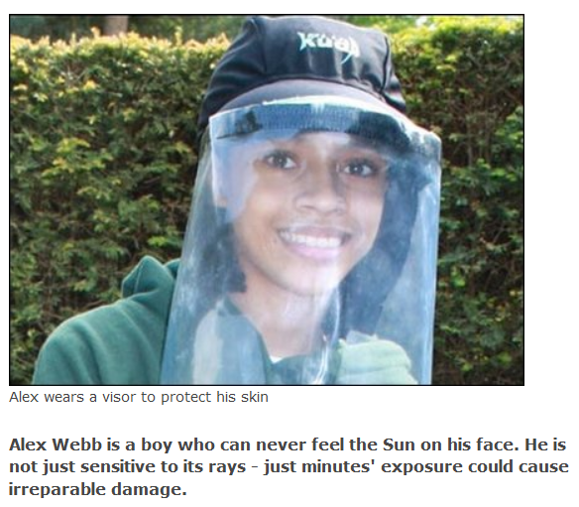
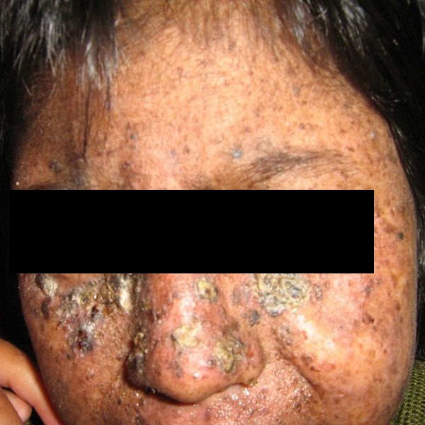
Xeroderma pigmentosum
!
Nucleotide excision repair (NER) defects
xeroderma pigmentosum (XP), and several similar dieseases
Notes:
Enzimek listája: http://www.cgal.icnet.uk/DNA_Repair_Genes.html
http://www.murphys-laws.com/murphy/murphy-laws.html
Development of many freckles at an early age; Multiple basal cell carcinomas (basaliomas) and other skin malignancies frequently occur at a young age in those with XP; metastatic malignant melanoma and squamous cell carcinoma are the two most common causes of death in XP victims.

Slide 30
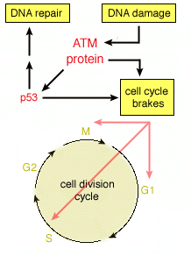
Ataxia telangiectasia
!
The ATM protein is a large serine-threonine kinase
regulating cell cycle checkpoints, repair of double stranded DNA
is a human autosomal recessive hereditary disease
a hundred-fold increase in cancer susceptibility.
Ataxia refers to poor coordination and telangiectasia to small dilated blood vessels.
Notes:
http://www-personal.k-state.edu/~bethmont/mutdes.html

Slide 31
Size of mutations
!
Large
Genome = Numerical chromosome
Medium
Structural chromosome
Small [gene mutations including point (base pair) mutations]
Length mutations or indel, DIP ( deletion/insertion polymorphism)
Deletions (transposones or single base)
Insertion (transposones or single base)
Repeat number variations
Single base substitutions (single nucleotide variation / polymorphism ≈ SNV / SNP)

Slide 32
Single Nucleotide Variants (SNV) Base substitution or SNV (a variation at a position that hasn’t been well characterized) or SNP (a well characterized allele in the population)
!
!
ATGGTAAGCCTGAGCTGACTTAGCGT
ATGGTAAACCTGAGTTGACTTAGCGT
↑ ↑
SNV SNV

Slide 33
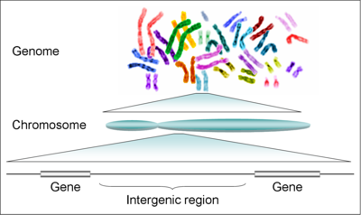
Types of SNVs
Intergenic
Intragenic
Coding
Non-coding
Regulatory region
Gene expression
Intron
Splicing
UTR
!

Slide 34
!
Consequence of mutations on different sites
1
3
2
4
5
6
6
6
1/ Promoter or other regulatory regions → reduced or no transcription
2/ 5’ UTR → reduced binding to ribosome and low translation
3/ Exon → amino acid substitution or truncated protein (early transcription termination)
4/ Intron → splicing mutation
5/ Polyadenylation site → low mRNS stability
6/ Other regulatory regions → altered rate of transcription

Slide 35
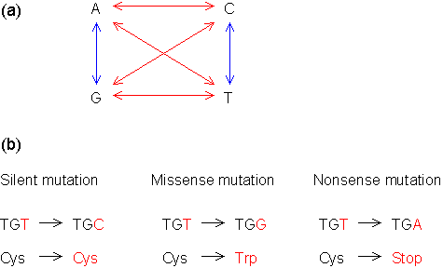
Base substitution (SNV) of coding region
!
Transition
Transversion (purine↔pyrimidine)
Neutral mutations are a type of missense mutation in which the new amino acid is chemically similar to the one it is replacing.
Notes:
Illustration of transition (blue) and transversion (red) mutations. In the transition mutation, a pyrimidine (C or T) is substituted by another pyrimidine, or a purine (A or G) is substituted by another purine. The transversion mutation involves the change from a pyrimidine to a purine, or vice versa. b. Examples of silent, missense and nonsense mutations. The silent mutation does not produce any change in the amino acid sequence, the missense mutation results in a different amino acid, and the nonsense mutation generates a stop signal. www.web-books.com/ MoBio/Free/Ch7E.htm
http://staff.jccc.net/PDECELL/evolution/mutations/mutation.html

Slide 36
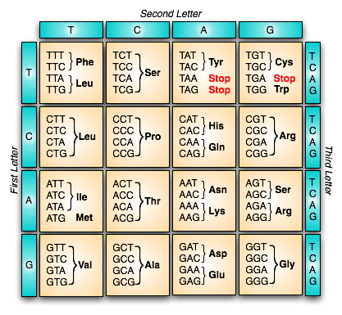
!
The genetic code is redundant
Features of genetic code dictionary
(Near) Universal
Three letter code
Redundant
Comma free
No overlapping
Wobbling

Slide 37
Missense mutation in sickle cell anemia
HBB: hemoglobin beta

Slide 38
Example of nonsense mutation
Early termination!

Slide 39
Significance of single nucleotide substitutions
Missense mutations
~50% of disease causing mutations
E.g. Cystic fibrosis (Mucoviscidosis)
Non-sense mutations
~12% of disease causing mutations
E. g. a form of
β⁰-thalassemia

Slide 40
Splicing mutations
Pre-mRNA
~12% of disease causing mutations
E.g.
some forms of β-thalassemia
Etc. see next slide
Pre-mRNA
Notes:
Example of exon skipping. Splicing of an intron requires an essential signal: "GT........AG". If the splice acceptor site AG is mutated (e.g., A to C in this figure), the splicing machinery will look for the next acceptor site. As a result, the exon between two introns is also removed.
www.web-books.com/ MoBio/Free/Ch7E.htm

Slide 41
Early loss of teeth may be caused by splicing mutation
Acatalasemia
(gene CAT - lack of catalase)
Leukocyte adhesion deficiency (LAD)
Beta-2 integrin splicing mutation ⇒
Notes:
http://www.dentalcasestudy.info/2012/12/leukocyte-adhesion-deficiency-case.html

Slide 42
Length mutations
Simple nucleotide insertion/deletion (InDel)

Slide 43
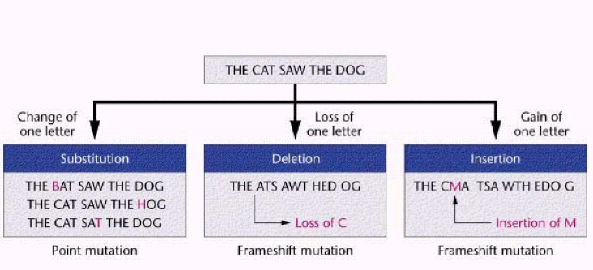
Consequences of substitution and InDel
(SNV)
Frame shift (shift of reading frame*)

Slide 44
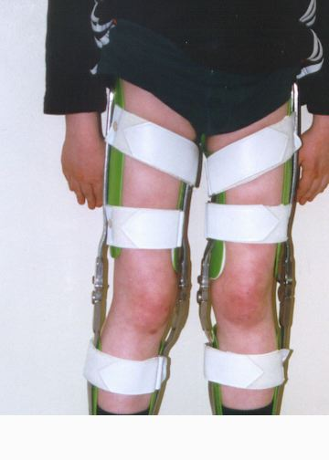
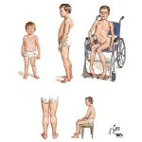
Significance of simple nucleotide InDel
~25% of disease causing mutations
Frame shift
E.g. DMD (Duchenne muscular dystrophy)

Slide 45
Example for allele (and phenotypic*) heterogeneity
* Different mutations on the same locus may cause similar diseases (allelic heterogeneity).

Slide 46
Other example for deletion
E.g. Hypodontia (Del Pax 9; 14q12)
X-ray of oral region

Slide 47
Length mutations
Repetitive insertions

Slide 48
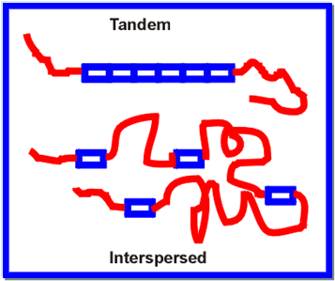
Repetitive insertions
Tandem repeats
Satellite DNA
pericentromeric heterochromatin
VNTR
Minisatellite
10-60 bp
Telomera
Microsatellite (STR=short tandem repeats)
2-6 bp
good markers of kinship
Repeat number expansion ⇒ diseases
Interspersed repeats:
SINEs (Short Interspersed Elements)
LINEs (Long …) e. g. L1

Slide 49
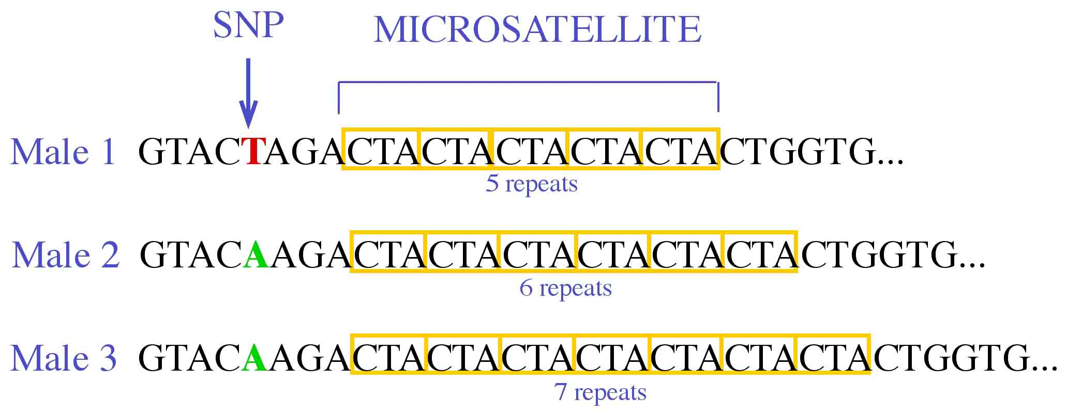
Microsatellite repeat number expansion (STR: short tandem repeats)

Slide 50
Diseases caused by trinucleotide repeat insertions
(MD1)
CUG
coding region of mRNA
Non-coding region of mRNA
Kennedy's disease (KD) = X-linked spinal-bulbar muscular atrophy (SBMA) is a neuromuscular disease associated with mutations of the androgen receptor (AR).
Notes:
www.web-books.com/ MoBio/Free/Ch7E.htm
Kennedy's disease (KD) or X-linked spinal-bulbar muscular atrophy (SBMA) is a neuromuscular disease associated with mutations of the androgen receptor (AR). Because of its endocrine manifestations related to the impairment of the AR, it can be viewed as a variation of the disorders of the androgen insensitivity syndrome (AIS). It is named after WR Kennedy, a neurologist who was among the first to describe this disease.

Slide 51
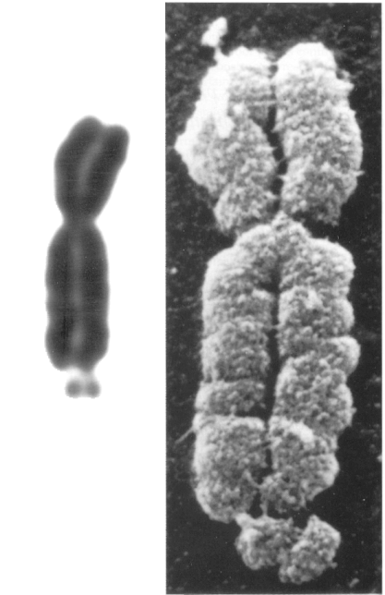
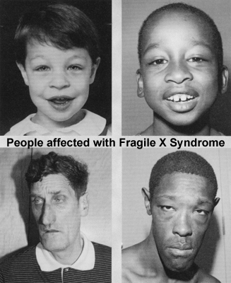
Phenotype of Fragile X syndrome
Fragile site
* Most frequent cause of mental retardation in males

Slide 52
Trinucleotide reapat expansion in coding region:
Polyglutamine
CAG
Gain of function
Various proteins
Aggregation
Apoptosis
Neurodegeneration
E.g Huntington dis.
Expansion
Replication slippage
Polyalanine
GCX
Loss-of-function
Transcription factors
Maldevelopment
E.g. Synpolydacty
(Homeobox D13)
Constant repeat number
Unequal crossing over

Slide 53
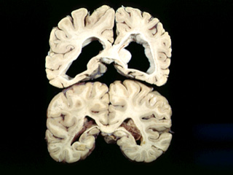
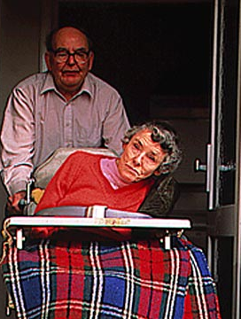
Neurodegeneration in Huntington

Slide 54
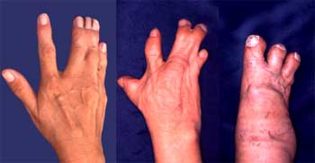
A polyalanine disease
Disease Gene
Synpolydactyly II. HOXD13

Slide 55
Trinucleotide repeat exopansion happens preferentially during spermatogenesis or oogenesis
Myotonyc dystrophy
Preferentially in oogeneseis
Fragile X syndrome
Exclusively during oogenesis
Daughters of unaffected transmitting males are never affected
Huntington
Instability is greater in spermatogenesis
Once a DNA repeat begins to expand (premutation) expansion can continue with each succeeding generation
This dynamism explains the phenomenon called genetic anticipation, when the age of onset is younger in every generation or accompanied more severe phenotype.

Slide 56
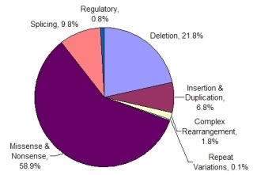
Frequencies of disease causing mutations

